Slide 1
Ontario Beach Tourism Statistics 2015
Fall 2017

Slide 2
This report summarizes key characteristics of visitors and visitor spending of trips in Ontario which included going to a Beach Data was sourced from Statistics Canada’s Travel Survey of the Residents of Canada and International Travel Survey, 2015 Some slides include an index table which simplifies the comparison of Beach and total trip statistics. Since total trips equals 100, an index of 105 indicates Beach is 5% higher than total, similarly an index of 90 signifies Beach is 10% lower than total. Index Interpretation less than 80 Beach trips underdeveloped versus total trips 80-120 Beach trips similar to total trips greater than 120 Beach trips overdeveloped versus total trips
2

Slide 3
Visits and Spending
Region | Visits (millions) | Visitor Spending ($ billions)
Ontario Total | 141.9 | 25.4
Ontario Beach | 6.3 | 1.6
Ontario Beach proportion of Ontario Total | 4.5% | 6.2%
In 2015, there were 6.3 million Beach visits in Ontario, representing 4.5% of total visits in Ontario
Beach visitors spent $1.6 billion, accounting for 6.2% of total visitor spending in Ontario
Source: Statistics Canada’s Travel Survey of the Residents of Canada and International Travel Survey 2015; Ontario Ministry of Tourism, Culture and Sport

Slide 4
Beach and Total Visits by Origin
Beach vs. Total | Visit Index
Ontario | 102
U.S. | 49
Other Canada | 131
Overseas | 138
Ontario residents accounted for the majority of Beach (88%) and total (86%) visits
U.S. visitors accounted for 4% of Beach visits compared to 8% of total visits
Visitors from Other Canada comprised 6% of Beach visits and 5% of total visits
Overseas visitors accounted for 2% of Beach visits and 2% of total visits
Source: Statistics Canada’s Travel Survey of the Residents of Canada and International Travel Survey 2015; Ontario Ministry of Tourism, Culture and Sport

Slide 5
Beach and Total Spending by Origin
Beach vs. Total | Spending Index
Ontario | 114
U.S. | 57
Other Canada | 111
Overseas | 87
Ontario residents accounted for 63% of Beach and 55% of total spending
U.S. visitors accounted for 8% of Beach spending compared to 14% of total spending
Visitors from Other Canada comprised 10% of Beach spending and 9% of total spending
Overseas visitors accounted for 19% of Beach spending and 22% of total spending
Source: Statistics Canada’s Travel Survey of the Residents of Canada and International Travel Survey 2015; Ontario Ministry of Tourism, Culture and Sport

Slide 6
Ontario Beach Visitors by Region of Residence
Beach vs. Total | Visits from Ontario Index
Reg 1 | 104
Reg 2 | 80
Reg 3 | 92
Reg 4 | 112
Reg 5 | 108
Reg 6 | 130
Reg 7 | 91
Reg 8 | 42
Reg 9 | 48
Reg 10 | 105
Reg 11 | 52
Reg 12 | 37
Reg 13 | 117
24% of Beach visitors from Ontario are from Region 5 compared to 22% of total visits, 18% from Region 6 (14% total visits), and 12% from Region 1 (12% total visits)
Note: Ontario origin Beach visitors represented 88% (5.5 million) of visits and 63% ($989 M) of visitor spending
Source: Statistics Canada’s Travel Survey of the Residents of Canada and International Travel Survey 2015; Ontario Ministry of Tourism, Culture and Sport
6

Slide 7
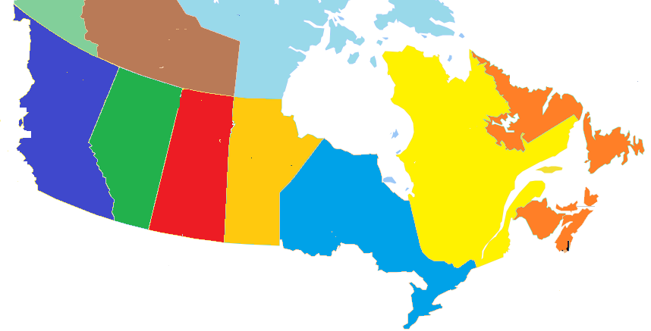
Other Canada Beach Visitors by Province of Residence
BC
5%
(7%)
Beach visits
(Total visits)
AB
6%
(7%)
SK
4%
(2%)
MB
27%
(10%)
QC
52%
(66%)
NL/NB/NS/PE
6%
(8%)
52% of Other Canada Beach visitors came from Quebec, compared to 66% of total visits and 27% from Manitoba (vs 10% total)
Note: Other Canada Beach visitors represented 6% (382,000) of visits and 10% ($158 M) of visitor spending
Source: Statistics Canada’s Travel Survey of the Residents of Canada and International Travel Survey 2015; Ontario Ministry of Tourism, Culture and Sport
7

Slide 8
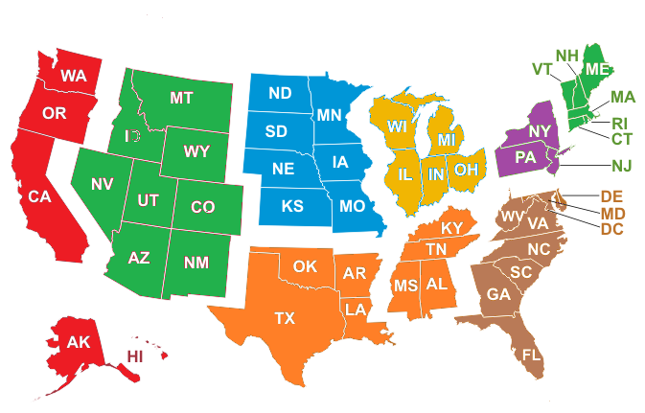
U.S. Beach Visitors by Region of Residence
Beach visits
(Total visits)
Mountain
10%
(2%)
West North Central
16%
(5%)
East North Central
34%
(39%)
New England
3%
(4%)
Pacific, Alaska, Hawaii
9%
(3%)
Mid Atlantic
11%
(36%)
South Atlantic
11%
(8%)
South Central
6%
(3%)
34% of U.S. Beach visitors came from East North Central states (Michigan, Ohio, Illinois, Indiana, and Wisconsin) and 16% from West North Central states
Note: U.S. Beach visitors represented 4% (249,000) of visits and 8% ($129 M) of visitor spending
Source: Statistics Canada’s Travel Survey of the Residents of Canada and International Travel Survey 2015; Ontario Ministry of Tourism, Culture and Sport
8

Slide 9
Overseas Beach Visitors by Country of Residence
Ontario’s 9 overseas target markets represent 57% of overseas Beach visitors versus 54% of total overseas visits
Note: Overseas Beach visitors represented 2% (158,000) of visits and 19% ($298 M) of visitor spending
Source: Statistics Canada’s Travel Survey of the Residents of Canada and International Travel Survey 2015; Ontario Ministry of Tourism, Culture and Sport
9

Slide 10
Destination – Beach Visits by Region
Beach vs. Total | Destination Index
Reg 1 | 115
Reg 2 | 51
Reg 3 | 27
Reg 4 | 86
Reg 5 | 32
Reg 6 | 27
Reg 7 | 251
Reg 8 | 177
Reg 9 | 132
Reg 10 | 40
Reg 11 | 271
Reg 12 | 369
Reg 13 | 163
22% of Beach visits took place in Region 7 compared to 9% of total visits, 13% in Region 1 (11% total), and 12% in Region 12 (3% total)
Source: Statistics Canada’s Travel Survey of the Residents of Canada and International Travel Survey 2015; Ontario Ministry of Tourism, Culture and Sport
10

Slide 11
Beach Visits by Length of Stay
Beach vs. Total | Length of Stay Index
Same-day | 28
Overnight | 226
Avg # nights | 122
The majority (82%) of Beach visits were overnight visits. For comparison, 36% of total visits in Ontario were overnight visits
The average number of nights spent on Beach visits was 3.8, above Ontario’s average of 3.2 nights
Source: Statistics Canada’s Travel Survey of the Residents of Canada and International Travel Survey 2015; Ontario Ministry of Tourism, Culture and Sport

Slide 12
Beach $/Trip by Length of Stay
Beach vs. Total | $/Trip Index
Total | 139
Same-day | 81
Overnight | 83
Beach visitors spent an average of $249/trip ($179/trip for total trips)
Total trip spending, not just spending on Beach
Source: Statistics Canada’s Travel Survey of the Residents of Canada and International Travel Survey 2015; Ontario Ministry of Tourism, Culture and Sport

Slide 13
Beach Spending by Category
Beach vs. Ontario | Spending Index
Transportation | 79
Accommodation | 137
Food & Beverage | 118
Rec./Entertain. | 88
Retail/Other | 78
The largest proportions of expenditures were spent on Food & Beverage (32% Beach, 27% total), Transportation (28% Beach, 36% total), and Accommodations (23% Beach, 17% total)
Source: Statistics Canada’s Travel Survey of the Residents of Canada and International Travel Survey 2015; Ontario Ministry of Tourism, Culture and Sport

Slide 14
Other Activities done by Beach Visitors
Activity | Beach Visit Participation | Index vs Total
Any Outdoor/Sports Activity | 100% | 582
Visit a beach | 100% | 2241
Boating | 33% | 815
Hiking | 29% | 655
Camping | 27% | 834
Canoeing | 21% | 967
Wildlife/Bird watching | 21% | 940
Fishing | 21% | 614
National/Provincial Nature Parks | 19% | 687
Cycling | 13% | 1110
Activity | Beach Visit Participation | Index vs Total
Visit Friends or Relatives | 11% | 32
Historic Sites | 9% | 274
Restaurant or bar | 7% | 117
Sightseeing | 7% | 118
Golfing | 7% | 541
Museums/Art Galleries | 7% | 245
Shopping | 6% | 71
Festivals/Fairs | 6% | 222
Play a sport | 6% | 271
Cultural Performances | 4% | 106
Activity | Beach Visit Participation | Index vs Total
Sports Events | 3% | 76
Zoos/Aquariums/Botanical Gardens | 3% | 171
Theme Parks | 3% | 224
Casinos | 2% | 92
Hunting | 2% | 346
Movies | 1% | 143
Indigenous | 1% | 426
ATV | 1% | 258
Business Meeting/Conference/Seminar | 1% | 13
Cross-country Skiing | 0% | 139
Medical/Dental appointment | 0% | 24
33% of Beach visitors went boating, 29% went hiking, 27% went camping
Source: Statistics Canada’s Travel Survey of the Residents of Canada and International Travel Survey 2015; Ontario Ministry of Tourism, Culture and Sport

Slide 15
Main Purpose of Beach Visit
Beach vs. Total | Purpose Index
Pleasure | 214
VFR | 49
Business | 6
Other | 17
VFR: Visiting Friends and / or Relatives
Most trips were pleasure trips (75% compared to 35% of total trips)
Other includes shopping, medical, religious, hobby/trade show, etc.
Source: Statistics Canada’s Travel Survey of the Residents of Canada and International Travel Survey 2015; Ontario Ministry of Tourism, Culture and Sport

Slide 16
Beach Visits by Accommodation Type
Beach vs. Total | Type Index
Private | 93
Commercial | 71
Campground | 349
18% of overnight Beach visits were spent at commercial accommodations compared to 26% of total visits
18% of overnight Beach visits were spent in camping/RV facilities versus 5% of total visits
Source: Statistics Canada’s Travel Survey of the Residents of Canada and International Travel Survey 2015; Ontario Ministry of Tourism, Culture and Sport

Slide 17
Beach Visits by Time of Year
Beach vs. Total | Quarter Index
Jan-Mar | 9
Apr-Jun | 97
Jul-Sept | 224
Oct-Dec | 17
The largest proportions of trips occur in Jul-Sep (69% Beach vs 31% total)
Source: Statistics Canada’s Travel Survey of the Residents of Canada and International Travel Survey 2015; Ontario Ministry of Tourism, Culture and Sport
17

Slide 18
Beach Visits by Gender
Beach vs. Total | Gender Index
Male | 94
Female | 107
About half of Beach visits were among males and half among females. For comparison, 54% of total visits in Ontario were among male visitors
Source: Statistics Canada’s Travel Survey of the Residents of Canada and International Travel Survey 2014; Ontario Ministry of Tourism, Culture and Sport

Slide 19
Beach Visits by Party Size
Beach vs. Total | Party Size Index
1 person | 37
2 persons | 93
3+ persons | 215
Avg party size | 165
With children | 203
Avg Party Size 3.8 2.3
With children 25% 12%
51% of Beach visits were among groups of 3 or more people compared to 24% of total visits
25% of Beach visits included children versus 12% of total visits
Source: Statistics Canada’s Travel Survey of the Residents of Canada and International Travel Survey 2015; Ontario Ministry of Tourism, Culture and Sport
19

Slide 20
Domestic Beach Visitor’s Income
Beach vs. Total | Income Index
< $50 K | 74
$50 K- $75 K | 89
$75 K - $100 K | 93
$100 K+ | 126
45% of Canadian Beach visitors in Ontario had a household income greater than $100,000 compared to 36% of total visitors
Source: Statistics Canada’s Travel Survey of the Residents of Canada 2015; Ontario Ministry of Tourism, Culture and Sport

Slide 21
Domestic Beach Visitor’s Education
Beach vs. Ontario | Education Index
< High School | 45
High School | 103
Some post-secondary | 91
University degree | 121
39% of Canadian Beach visitors in Ontario had a university degree compared with 32% of total visits
Source: Statistics Canada’s Travel Survey of the Residents of Canada 2015; Ontario Ministry of Tourism, Culture and Sport

Slide 22
Beach Summary
In 2015, there were 6.3 million Beach visits in Ontario, representing 4.5% of total visits in Ontario. Beach visitors spent $1.6 billion, or 6.2% of total visitor spending in Ontario.
Ontario residents accounted for 88% of visits and 63% of spending, residents of Other Canada accounted for 6% of visits and 10% of spending, U.S. visitors represented 4% of visits and 8% of expenditures, and overseas visitors accounted for 2% of visits and 19% of spending
24% of Beach visitors from Ontario are from Region 5 compared to 22% of total visits, 18% from Region 6 (14% total visits), and 12% from Region 1 (12% total visits)
22% of Beach visits took place in Region 7 compared to 9% of total visits, 13% in Region 1 (11% total), and 12% in Region 12 (3% total)

Slide 23
Beach Summary
The majority (82%) of Beach visits were overnight visits. For comparison, 36% of total visits in Ontario were overnight visits. The average number of nights spent on Beach visits was 3.8, above Ontario’s average of 3.2 nights
Beach visitors spent an average of $249/trip ($179/trip for total trips)
The largest proportions of expenditures were spent on Food & Beverage (32% Beach, 27% total), Transportation (28% Beach, 36% total), and Accommodations (23% Beach, 17% total)
33% of Beach visitors went boating, 29% went hiking, 27% went camping
Most trips were pleasure trips (75% compared to 35% of total trips)

Slide 24
Beach Summary
18% of overnight Beach visits were spent at commercial accommodations compared to 26% of total visits. 18% of overnight Beach visits were spent in camping/RV facilities versus 5% of total visits
The largest proportions of trips occur in Jul-Sep (69% Beach vs 31% total)
51% of Beach visits were among groups of 3 or more people compared to 24% of total visits. 25% of Beach visits included children versus 12% of total visits
45% of Canadian Beach visitors in Ontario had a household income greater than $100,000 compared to 36% of total visitors
39% of Canadian Beach visitors in Ontario had a university degree compared with 32% of total visits

