Slide 1
Ontario Indigenous Tourism Statistics 2015
Fall 2017

Slide 2
This report summarizes key characteristics of visitors and visitor spending of trips in Ontario which included attending an Indigenous event (pow wow, performance, other) Data was sourced from Statistics Canada’s Travel Survey of the Residents of Canada and International Travel Survey, 2015 Some slides include an index table which simplifies the comparison of Indigenous and total trip statistics. Since total trips equals 100, an index of 105 indicates Indigenous is 5% higher than total, similarly an index of 90 signifies Indigenous is 10% lower than total. Index Interpretation less than 80 Indigenous trips underdeveloped versus total trips 80-120 Indigenous trips similar to total trips greater than 120 Indigenous trips overdeveloped versus total trips
2

Slide 3
Visits and Spending
Region | Visits (millions) | Visitor Spending ($ billions)
Ontario Total | 141.9 | 25.4
Ontario Indigenous | 0.2 | 0.1
Ontario Indigenous proportion of Ontario Total | 0.2% | 0.3%
In 2015, there were 249,000 Indigenous visits in Ontario, representing 0.2% of total visits in Ontario
Indigenous visitors spent $69 million, accounting for 0.3% of total visitor spending in Ontario
Source: Statistics Canada’s Travel Survey of the Residents of Canada and International Travel Survey 2015; Ontario Ministry of Tourism, Culture and Sport

Slide 4
Indigenous and Total Visits by Origin
Indigenous vs. Total | Visit Index
Ontario | 93
U.S. | 91
Other Canada | 136
Overseas | 373
Ontario residents accounted for the majority of Indigenous (80%) and total (86%) visits
U.S. visitors accounted for 7% of Indigenous visits compared to 8% of total visits
Visitors from Other Canada comprised 6% of Indigenous visits and 5% of total visits
Overseas visitors accounted for 7% of Indigenous visits and 2% of total visits
Source: Statistics Canada’s Travel Survey of the Residents of Canada and International Travel Survey 2015; Ontario Ministry of Tourism, Culture and Sport

Slide 5
Indigenous and Total Spending by Origin
Indigenous vs. Total | Spending Index
Ontario | 69
U.S. | 196
Other Canada | 110
Overseas | 110
Ontario residents accounted for 38% of Indigenous and 55% of total spending
U.S. visitors accounted for 28% of Indigenous spending compared to 14% of total spending
Visitors from Other Canada comprised 10% of Indigenous spending and 9% of total spending
Overseas visitors accounted for 24% of Indigenous spending and 22% of total spending
Source: Statistics Canada’s Travel Survey of the Residents of Canada and International Travel Survey 2015; Ontario Ministry of Tourism, Culture and Sport

Slide 6
Ontario Indigenous Visitors by Region of Residence
Indigenous vs. Total | Visits from Ontario Index
Reg 1 | 45
Reg 2 | 0
Reg 3 | 71
Reg 4 | 56
Reg 5 | 27
Reg 6 | 9
Reg 7 | 764
Reg 8 | 0
Reg 9 | 43
Reg 10 | 0
Reg 11 | 38
Reg 12 | 0
Reg 13 | 159
64% Indigenous visitors from Ontario are from Region 7 compared to 8% of total visits, 8% from Region 13 (5% total visits), and 8% from Region 3 (11% total visits)
Note: Ontario origin Indigenous visitors represented 80% (198,000) of visits and 38% ($26 M) of visitor spending
Source: Statistics Canada’s Travel Survey of the Residents of Canada and International Travel Survey 2015; Ontario Ministry of Tourism, Culture and Sport
6

Slide 7
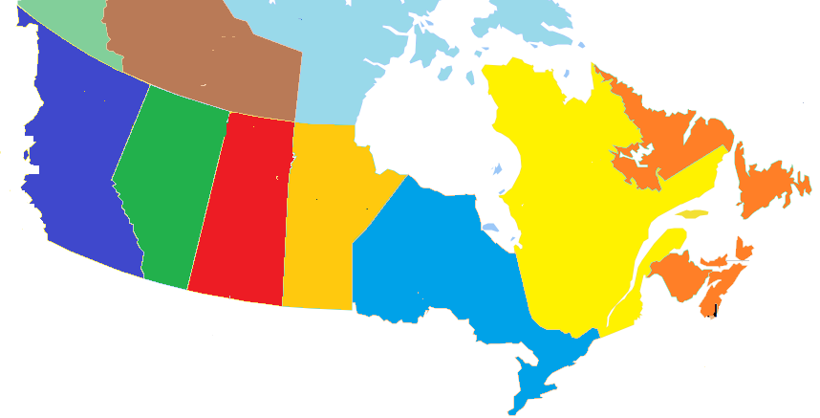
Other Canada Indigenous Visitors by Province of Residence
BC
0%
(7%)
Indigenous visits
(Total visits)
AB
0%
(7%)
SK
11%
(2%)
MB
7%
(10%)
QC
54%
(66%)
NL/NS/NB/PE
28%
(8%)
54% of Other Canada Indigenous visitors came from Quebec, compared to 66% of total visits
Note: Other Canada Indigenous visitors represented 6% (16,000) of visits and 10% ($7 M) of visitor spending
Source: Statistics Canada’s Travel Survey of the Residents of Canada and International Travel Survey 2015; Ontario Ministry of Tourism, Culture and Sport
7

Slide 8
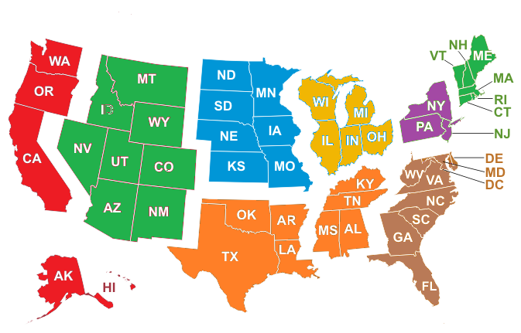
U.S. Indigenous Visitors by Region of Residence
Indigenous visits
(Total visits)
Mountain
0%
(2%)
West North Central
7%
(5%)
East North Central
38%
(39%)
New England
0%
(4%)
Pacific, Alaska, Hawaii
15%
(3%)
Mid Atlantic
9%
(36%)
South Atlantic
31%
(8%)
South Central
0%
(3%)
38% of U.S. Indigenous visitors came from East North Central states (Michigan, Ohio, Illinois, Indiana, and Wisconsin)
Note: U.S. Indigenous visitors represented 7% (18,000) of visits and 28% ($19 M) of visitor spending
Source: Statistics Canada’s Travel Survey of the Residents of Canada and International Travel Survey 2015; Ontario Ministry of Tourism, Culture and Sport
8

Slide 9
Overseas Indigenous Visitors by Country of Residence
Ontario’s 9 overseas target markets represent 68% of overseas Indigenous visitors versus 54% of total overseas visits
Note: Overseas Indigenous visitors represented 7% (17,000) of visits and 24% ($17 M) of visitor spending
Source: Statistics Canada’s Travel Survey of the Residents of Canada and International Travel Survey 2015; Ontario Ministry of Tourism, Culture and Sport
9

Slide 10
Destination – Indigenous Visits by Region
Indigenous vs. Total | Destination Index
Reg 1 | 74
Reg 2 | 76
Reg 3 | 0
Reg 4 | 4
Reg 5 | 60
Reg 6 | 24
Reg 7 | 574
Reg 8 | 30
Reg 9 | 87
Reg 10 | 124
Reg 11 | 29
Reg 12 | 116
Reg 13 | 207
51% of Indigenous visits took place in Region 7 compared to 9% of total visits, 13% in Region 13 (6% total), and 12% in Region 5 (20% total)
Source: Statistics Canada’s Travel Survey of the Residents of Canada and International Travel Survey 2015; Ontario Ministry of Tourism, Culture and Sport
10

Slide 11
Indigenous Visits by Length of Stay
Indigenous vs. Total | Length of Stay Index
Same-day | 6
Overnight | 264
Avg # nights | 91
The majority (95%) of Indigenous visits were overnight visits. For comparison, 36% of total visits in Ontario were overnight visits
The average number of nights spent on Indigenous visits was 2.9, below Ontario’s average of 3.2 nights
Source: Statistics Canada’s Travel Survey of the Residents of Canada and International Travel Survey 2015; Ontario Ministry of Tourism, Culture and Sport

Slide 12
Indigenous $/Trip by Length of Stay
Indigenous vs. Total | $/Trip Index
Total | 156
Same-day | 46
Overnight | 83
Indigenous visitors spent an average of $279/trip ($179/trip for total trips)
Total trip spending, not just spending on Indigenous
Source: Statistics Canada’s Travel Survey of the Residents of Canada and International Travel Survey 2015; Ontario Ministry of Tourism, Culture and Sport

Slide 13
Indigenous Spending by Category
Indigenous vs. Ontario | Spending Index
Transportation | 88
Accommodation | 147
Food & Beverage | 91
Rec./Entertain. | 141
Retail/Other | 67
The largest proportions of expenditures were spent on Transportation (32% Indigenous, 36% total), and Food & Beverage (25% Indigenous, 27% total)
Indigenous visitors spent a larger proportion on accommodations, 24%, than total visitors, 17%
Source: Statistics Canada’s Travel Survey of the Residents of Canada and International Travel Survey 2015; Ontario Ministry of Tourism, Culture and Sport

Slide 14
Other Activities done by Indigenous Visitors
Activity | Indigenous Visit Participation | Index vs Total
Indigenous | 100% | 57051
Visit Friends or Relatives | 66% | 198
Any Outdoor/Sports Activity | 36% | 207
National/Provincial Nature Parks | 24% | 861
Boating | 22% | 546
Museums/Art Galleries | 20% | 717
Historic Sites | 20% | 602
Festivals/Fairs | 19% | 701
Visit a beach | 19% | 426
Shopping | 19% | 207
Activity | Indigenous Visit Participation | Index vs Total
Sightseeing | 18% | 298
Restaurant or bar | 17% | 271
Sports Events | 16% | 393
Wildlife/Bird watching | 15% | 679
Cultural Performances | 15% | 377
Canoeing | 14% | 618
Golfing | 13% | 980
Camping | 12% | 380
Zoos/Aquariums/Botanical Gardens | 11% | 716
Theme Parks | 10% | 878
Activity | Indigenous Visit Participation | Index vs Total
Fishing | 10% | 298
Casinos | 10% | 380
Hiking | 10% | 216
Cycling | 8% | 705
Play a sport | 8% | 387
Medical/Dental appointment | 7% | 499
Business Meeting/Conference/Seminar | 7% | 153
Hunting | 6% | 1295
ATV | 6% | 2214
Snowmobiling | 5% | 1948
Skiing/Snowboarding | 5% | 726
Indigenous visitors participate in a variety of activities with 24% going to a park, 31% boating, and 20% visiting a museum/art gallery
Source: Statistics Canada’s Travel Survey of the Residents of Canada and International Travel Survey 2015; Ontario Ministry of Tourism, Culture and Sport

Slide 15
Main Purpose of Indigenous Visit
Indigenous vs. Total | Purpose Index
Pleasure | 66
VFR | 149
Business | 46
Other | 41
VFR: Visiting Friends and / or Relatives
Most trips were VFR trips (67% compared to 46% of total trips)
Other includes shopping, medical, religious, hobby/trade show, etc.
Source: Statistics Canada’s Travel Survey of the Residents of Canada and International Travel Survey 2015; Ontario Ministry of Tourism, Culture and Sport

Slide 16
Indigenous Visits by Accommodation Type
Indigenous vs. Total | Type Index
Private | 109
Commercial | 93
Campground | 168
24% of overnight Indigenous visits were spent at commercial accommodations compared to 26% of total visits
9% of overnight Indigenous visits were spent in camping/RV facilities versus 5% of total visits
Source: Statistics Canada’s Travel Survey of the Residents of Canada and International Travel Survey 2015; Ontario Ministry of Tourism, Culture and Sport

Slide 17
Indigenous Visits by Time of Year
Indigenous vs. Total | Quarter Index
Jan-Mar | 5
Apr-Jun | 232
Jul-Sept | 76
Oct-Dec | 64
The largest proportions of trips occurred in Apr-Jun (61% Indigenous vs 26% total) and Jul-Sep (23% Indigenous vs 31% total)
Source: Statistics Canada’s Travel Survey of the Residents of Canada and International Travel Survey 2015; Ontario Ministry of Tourism, Culture and Sport
17

Slide 18
Indigenous Visits by Gender
Indigenous vs. Total | Gender Index
Male | 45
Female | 163
Females made the majority (76%) of Indigenous visits. For comparison, 46% of total visits in Ontario were among female visitors
Source: Statistics Canada’s Travel Survey of the Residents of Canada and International Travel Survey 2015; Ontario Ministry of Tourism, Culture and Sport

Slide 19
Indigenous Visits by Party Size
Indigenous vs. Total | Party Size Index
1 person | 21
2 persons | 214
3+ persons | 48
Avg party size | 95
With children | 43
Avg Party Size 2.2 2.3
With children 5% 12%
80% of Indigenous visits were among groups of 2 people compared to 38% of total visits
5% of Indigenous visits included children less than total visits, 12%
Source: Statistics Canada’s Travel Survey of the Residents of Canada and International Travel Survey 2015; Ontario Ministry of Tourism, Culture and Sport
19

Slide 20
Domestic Indigenous Visitor’s Income
Indigenous vs. Total | Income Index
< $50 K | 27
$50 K- $75 K | 29
$75 K - $100 K | 23
$100 K+ | 70
25% of Canadian Indigenous visitors in Ontario had a household income greater than $100,000 compared to 35% of total visitors
62% of Canadian Indigenous visitors in Ontario had a household income not stated
Source: Statistics Canada’s Travel Survey of the Residents of Canada 2015; Ontario Ministry of Tourism, Culture and Sport

Slide 21
Domestic Indigenous Visitor’s Education
Indigenous vs. Ontario | Education Index
< High School | 38
High School | 310
Some post-secondary | 24
University degree | 71
23% of Canadian Indigenous visitors in Ontario had a university degree compared with 32% of total visits
Source: Statistics Canada’s Travel Survey of the Residents of Canada 2015; Ontario Ministry of Tourism, Culture and Sport

Slide 22
Indigenous Summary
In 2015, there were 249,000 Indigenous visits in Ontario, representing 0.2% of total visits in Ontario. Indigenous visitors spent $69 million, or 0.3% of total visitor spending in Ontario.
Ontario residents accounted for 80% of visits and 38% of spending, residents of Other Canada accounted for 6% of visits and 10% of spending, U.S. visitors represented 7% of visits and 28% of expenditures, and overseas visitors accounted for 7% of visits and 24% of spending
64% Indigenous visitors from Ontario are from Region 7 compared to 8% of total visits, 8% from Region 13 (5% total visits), and 8% from Region 3 (11% total visits)
51% of Indigenous visits took place in Region 7 compared to 9% of total visits, 13% in Region 13 (6% total), and 12% in Region 5 (20% total)

Slide 23
Indigenous Summary
The majority (95%) of Indigenous visits were overnight visits. For comparison, 36% of total visits in Ontario were overnight visits. The average number of nights spent on Indigenous visits was 2.9, below Ontario’s average of 3.2 nights
Indigenous visitors spent an average of $279/trip ($179/trip for total trips)
The largest proportions of expenditures were spent on Transportation (32% Indigenous, 36% total), and Food & Beverage (25% Indigenous, 27% total). Indigenous visitors spent a larger proportion on accommodations, 24%, than total visitors, 17%
Indigenous visitors participate in a variety of activities with 24% going to a park, 31% boating, and 20% visiting a museum/art gallery
Most trips were VFR trips (67% compared to 46% of total trips)

Slide 24
Indigenous Summary
24% of overnight Indigenous visits were spent at commercial accommodations compared to 26% of total visits. 9% of overnight Indigenous visits were spent in camping/RV facilities versus 5% of total visits
The largest proportions of trips occurred in Apr-Jun (61% Indigenous vs 26% total) and Jul-Sep (23% Indigenous vs 31% total)
80% of Indigenous visits were among groups of 2 people compared to 38% of total visits. 5% of Indigenous visits included children less than total visits, 12%
25% of Canadian Indigenous visitors in Ontario had a household income greater than $100,000 compared to 35% of total visitors. 62% of Canadian Indigenous visitors in Ontario had a household income not stated
23% of Canadian Indigenous visitors in Ontario had a university degree compared with 32% of total visits

