Slide 1

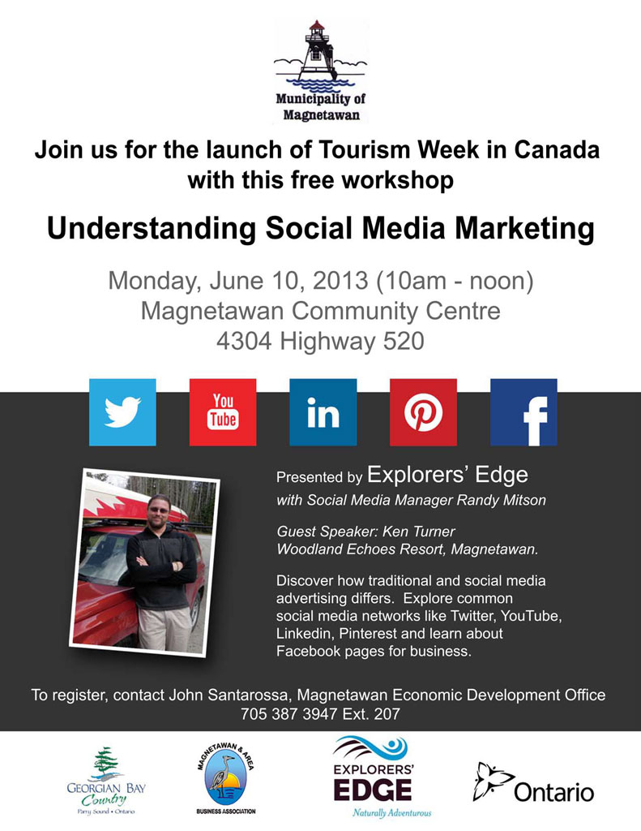
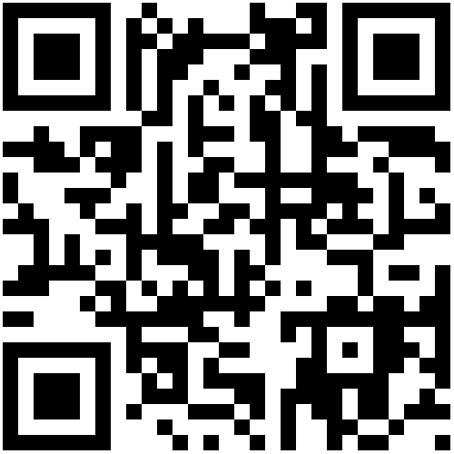

Slide 2
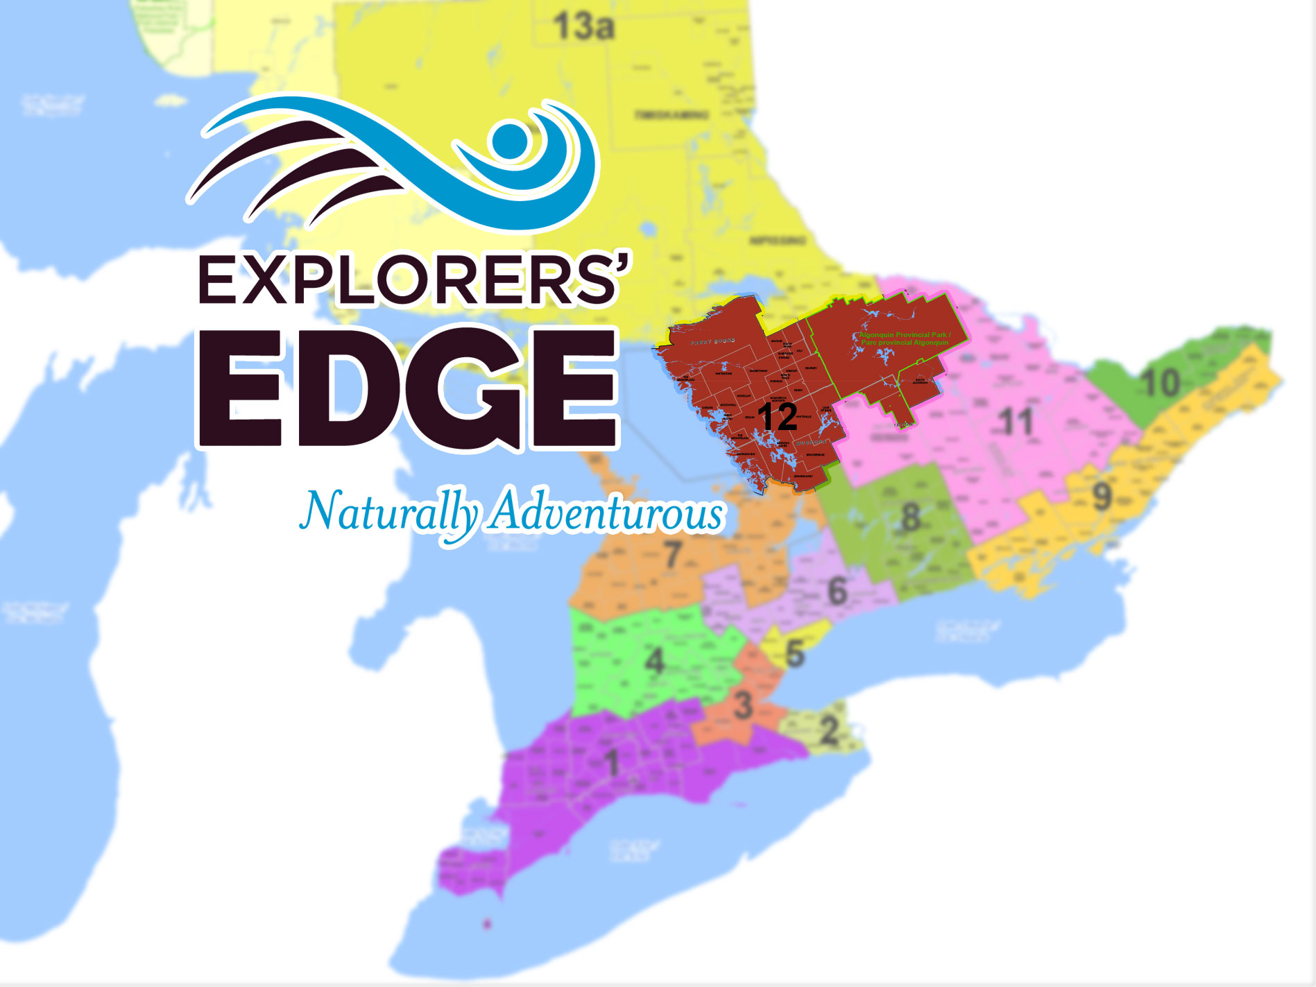
One of 13 RTOs funded by the Ontario Ministry of Tourism, Culture and Sport
Represents Algonquin Park, the Almaguin Highlands, Muskoka, Parry Sound

Slide 3
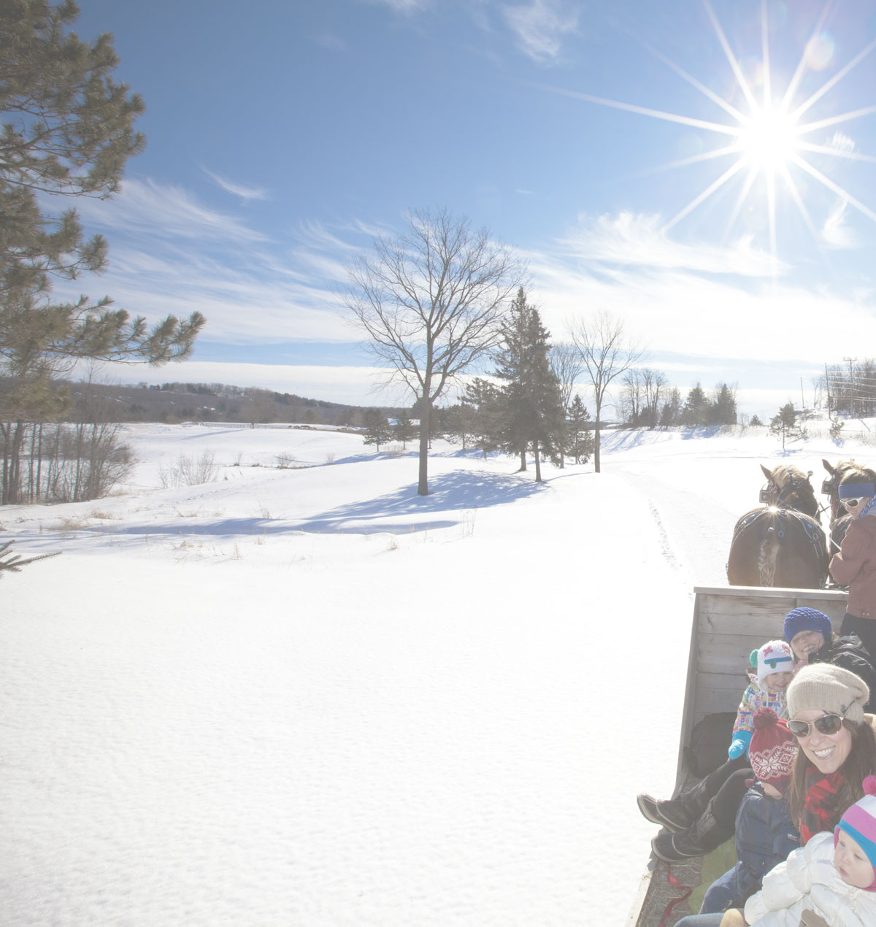
Main Strategies
  Change perceptions of the region as summer-only destination
  Build new audiences
  Focus on the shoulder seasons
  Always engage multiple operators

Slide 4
Understanding Social Media Marketing
Today’s Agenda:
  Traditional vs Social Marketing
  Social Media Platforms
  (Wikipedia lists 200+ social media sites)
    Facebook
    Twitter
    Youtube
    Linkedin
    Pinterest
    Blogs (Wordpress, Blogger, Tumbler, etc)
  Facebook Best Practices

Slide 5


Traditional Marketing
Newspapers • Radio • Magazines • Television • Websites
My Message
With traditional marketing, advertisers tell the public their message……

Slide 6

Social Media Marketing
Web 2.0 Sites • Word of Mouth • Social Networks
Social Marketing seeks to encourage word of mouth marketing
share experiences
likes & dislikes
encourages ownership
spreads virally
rewards clients
built on experiences

Slide 7
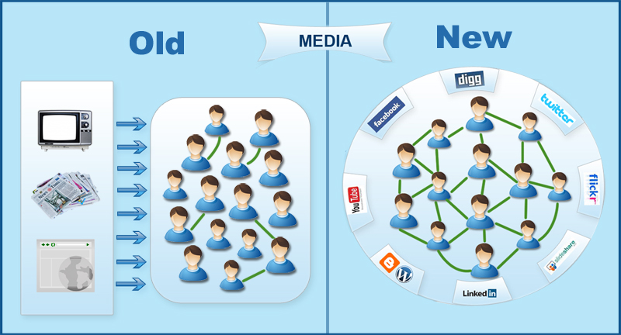
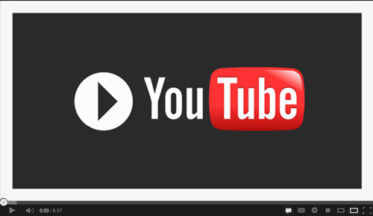
Traditional vs Social Marketing
Paid advertising vs earned experiences, levels the playing field
http://youtu.be/tPgQsv2KPwc

Slide 8
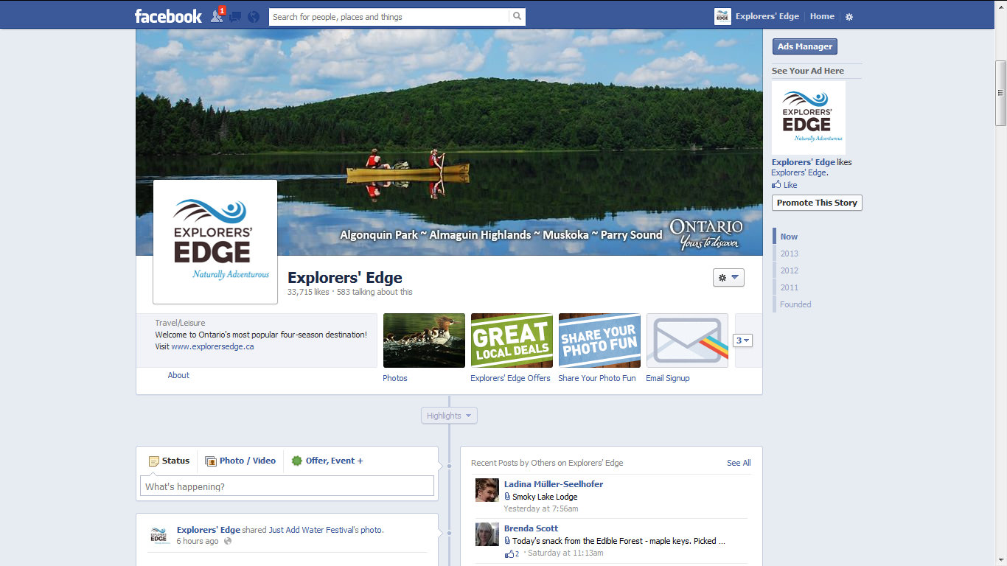

Social Media Networks
Facebook – February 2004 – 1+ Billion Registered Users
Facebook is the largest social media site and 2nd most visited webpage in the world!
1,200,000,000 registered users ^{(Nov 12th 2012)}
2/3rds of Canadians are on Facebook
With an average of 260 friends each
A Facebook page with 1000 fans (likes) could potentially be reaching up to 260,000 people!
Your clients ARE on Facebook!

Slide 9
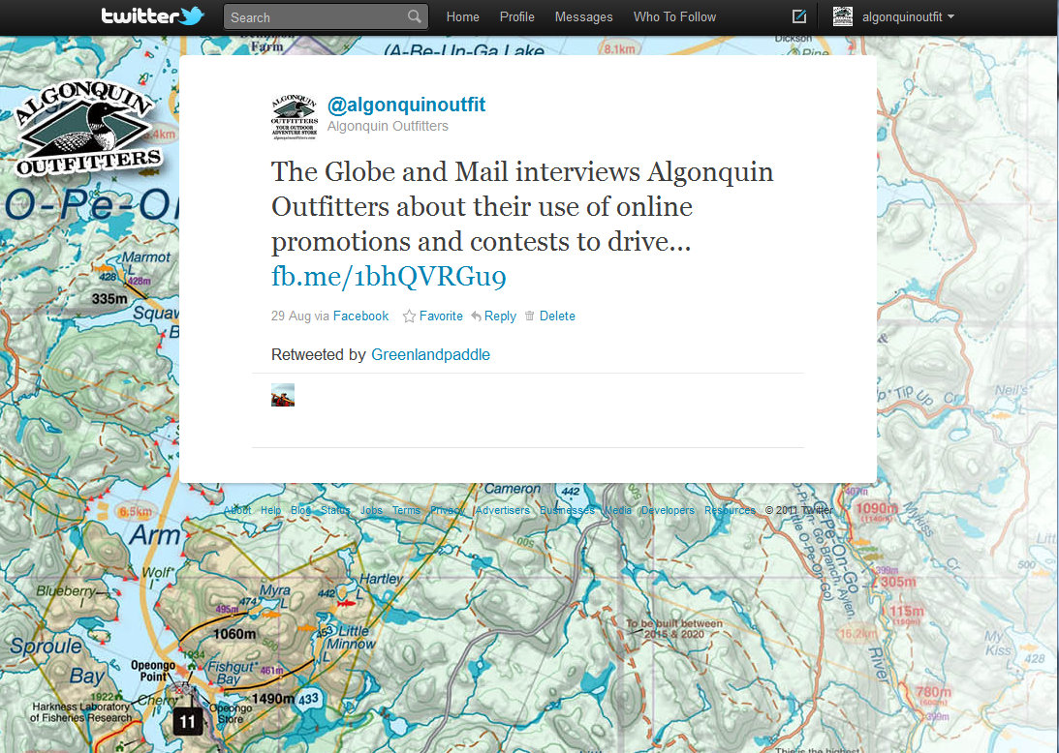

Social Media Networks
Twitter – July 15th 2006 – 500+ Million Registered Users
Twitter is a microblogging service that uses posts of up to 140 characters "tweets”
554,750,000 registered users (May 7th 2013)
340+ million tweets per day
limited to 140 characters
Include links, images, videos
Pick a short name as it’s part of your 140 limit
Customer Service & Connection

Slide 10
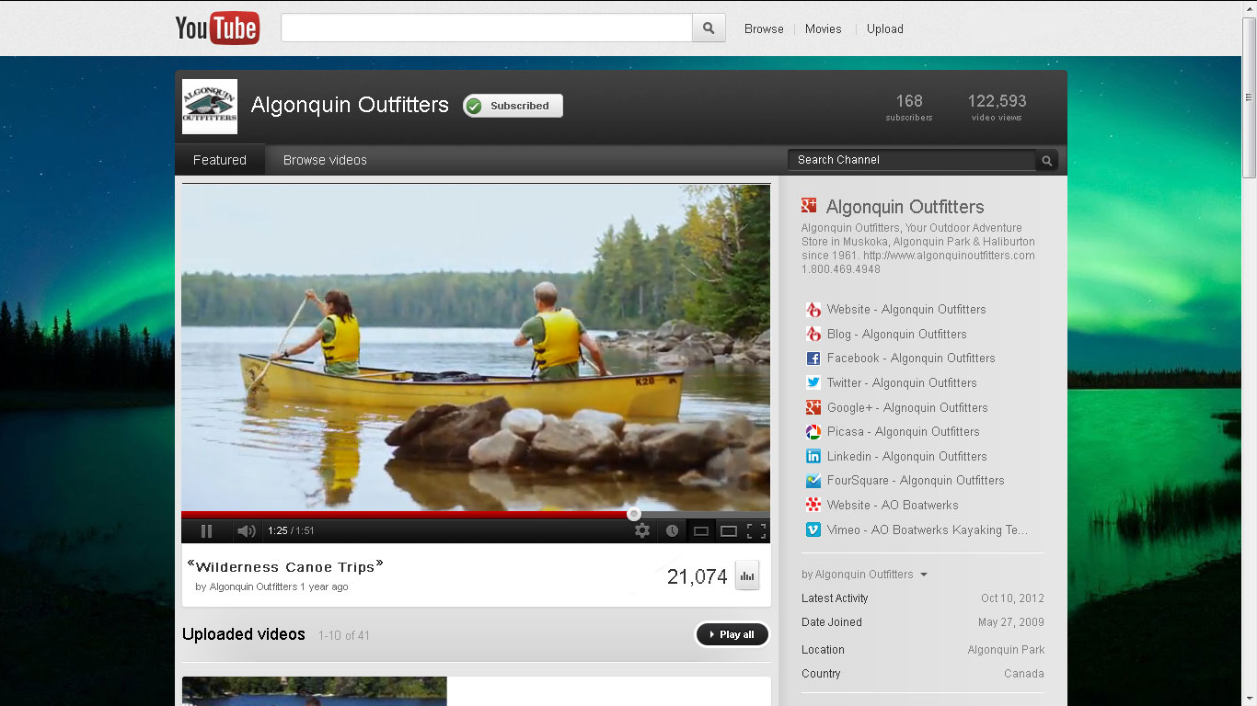

Social Media Networks
YouTube – February 2005 – 3rd most visited website
YouTube has over 800 million unique visitors worldwide who watch more than 4 billion videos each month.
YouTube was founded in Feb 2005
Janet Jackson’s “wardrobe malfunction” & Google bought for 1.65 Billion
YouTube is the 3rd most visited website in the world
YouTube is the 2nd largest search engine in the world
Over 1 trillion videos have been viewed on YouTube
“How to” videos are growing rapidly
Include link to your website & social networks
YouTube: www.youtube.com

Slide 11

Social Media Networks
Linkedin – 2003– 500+ Million Registered Users
Linkedin has 225 million members world wide connecting business to business & person to person
Linkedin was launched in 2003 making it OLD!
72% of it’s members are 25-54 years of age
Linkedin connects and introduces people
Linkedin hosts many groups and discussions
Find a mentor or new employee on Linkedin
Linkedin: www.linkedin.com

Slide 12

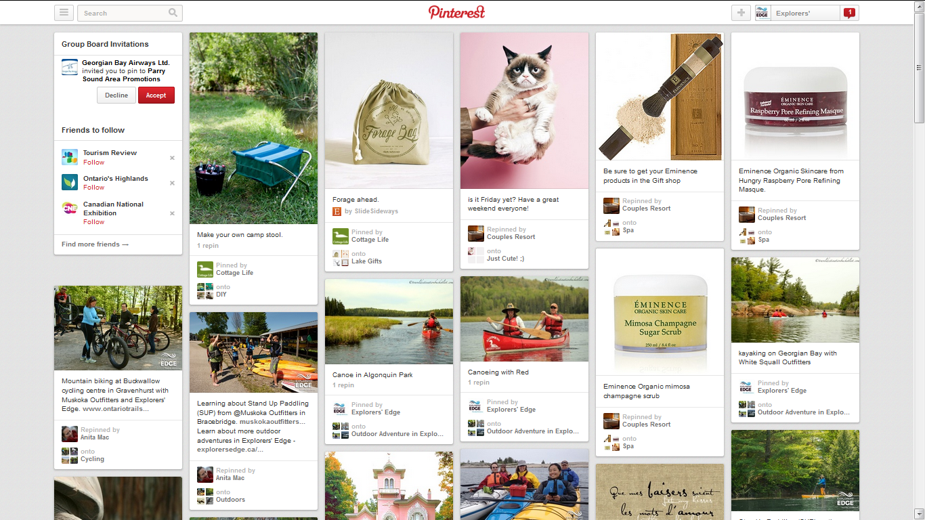
Social Media Networks
Pinterest – March 2010 – 48.7 million users
Pinterest is a pinboard-style photo-sharing website that allows users to create and manage theme-based image collections such as events, interests, and hobbies
Fastest social site to break 10m users
80% of users are women
80% of pinned photos are repined
Pinterest: www.pinterest.com

Slide 13
Social Media Networks
Blogs – 1990’s – Evolution of Websites
Blogs have been around since the early days of the web, evolving to be entire websites and even social now.
Google’s Blogger.com
Wordpress.com blogging/website software
Chronological posts, add comments and social media links to bring them into Web 2.0
Drive social traffic to your website.
Go Social With Your Blogs

Slide 14
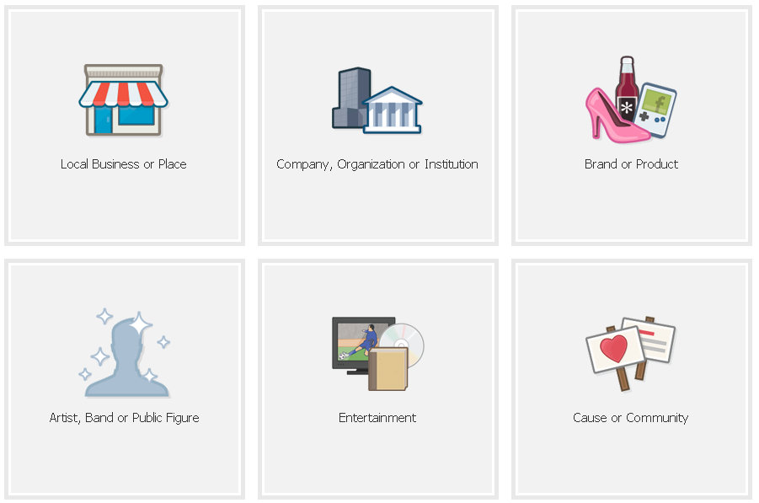
Facebook Best Practices
Getting started with the biggest and most popular social site
Facebook is by far the most popular social media site on the web.
Three Faces of Facebook
  Facebook Profile
  Facebook Group
  Facebook Page
Start your Page here: www.facebook.com/pages/create.php

Slide 15
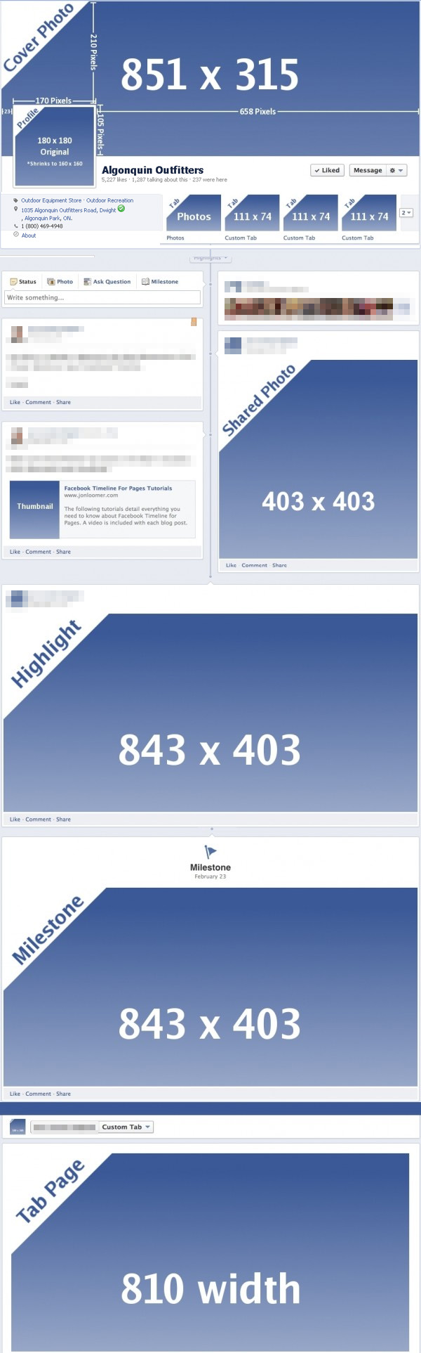
Facebook Best Practices
Create a custom brand look for your page
Lasting First Impressions
If people don’t like what they see they are less likely to become engaged in your page: (Match your website)
Looks are important
Profile Image 180x180 pixels, viewable as a small thumbnail
Cover Image 815x315 show off your brand experience
  20% text over image is all that’s allowed
  Custom Tab images 111x74
  Shared large photo 403x403
  Highlight & Milestone images 843x403
  Tab App pages are 810 in width

Slide 16
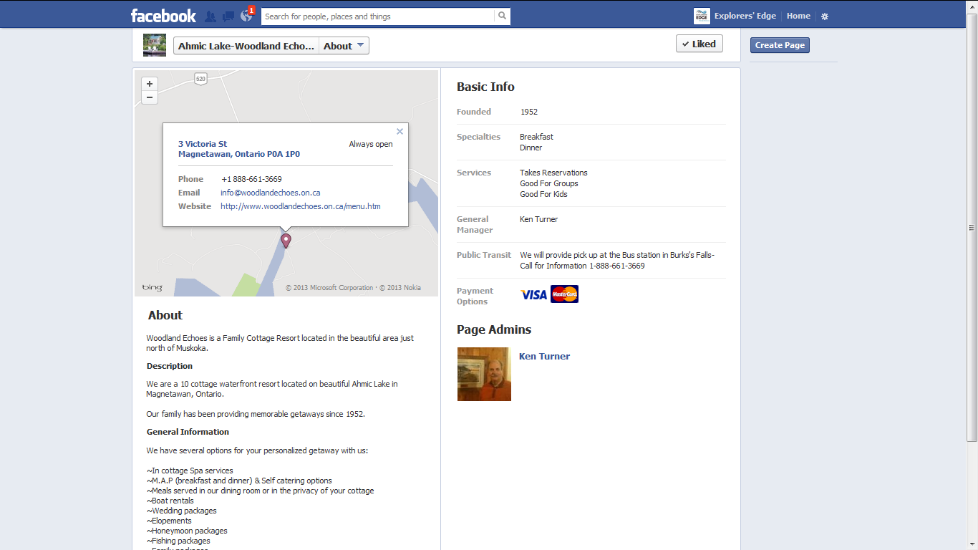
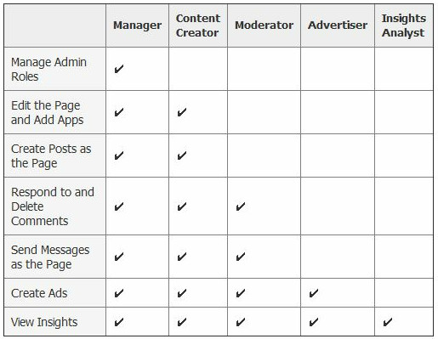
Facebook Best Practices
Complete the About Us section
Facebook Settings to Optimize
It’s important to have a Completed page profile with full contact information.
From your Admin Panel click on “Edit Page”
Click “Update Info” from drop down menu
Under Basic Information set the “Username”
Complete your page information here to include a description of your business, how to contact you, links to your website and other social media sites.
Select who will be page Managers (Owners)

Slide 17
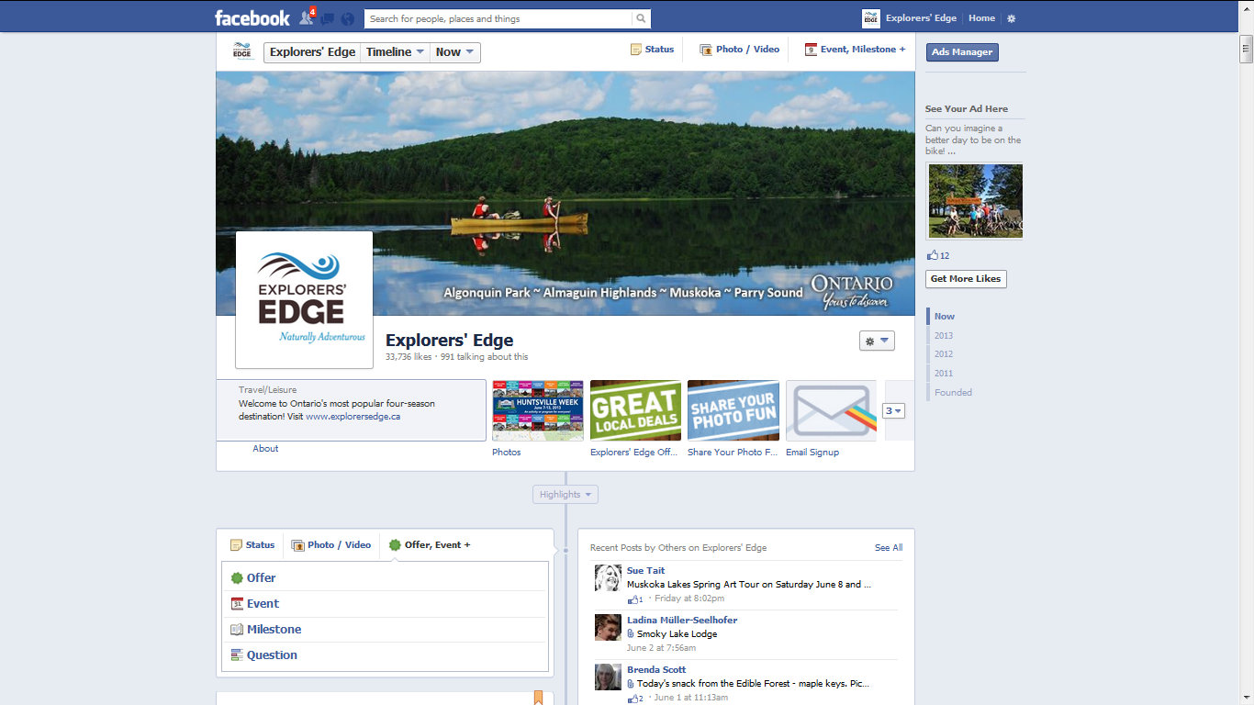
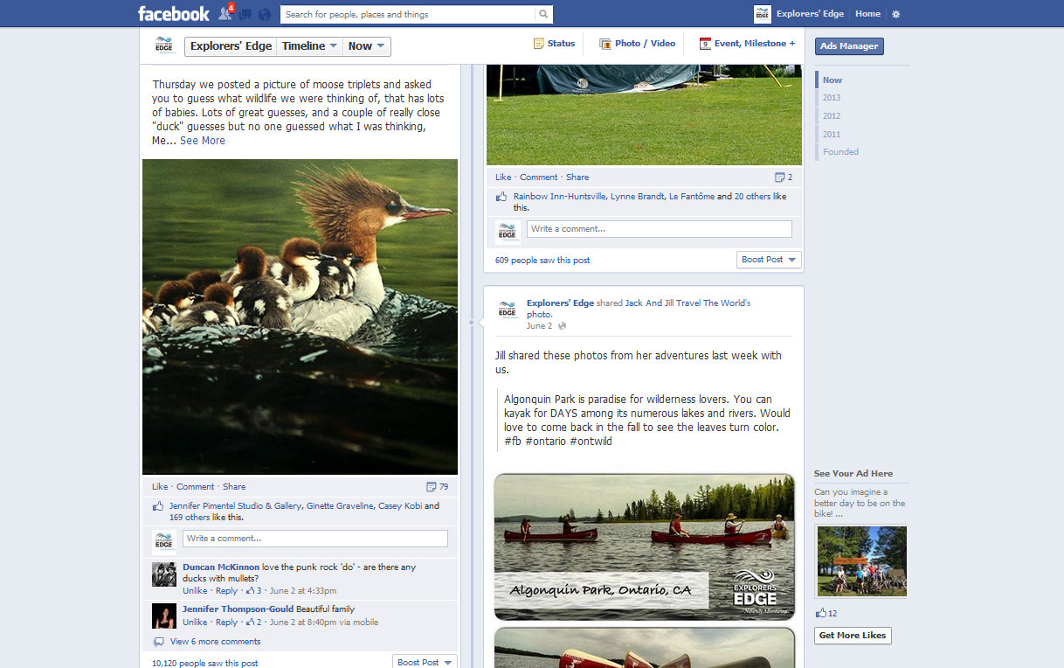
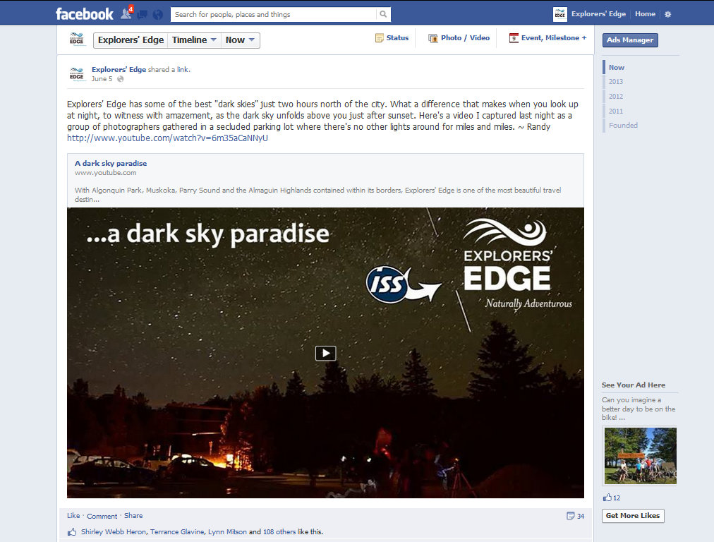
Facebook Best Practices
Creating Engaging Content
The best (non paid) way to grow your Facebook audience is to “engage” them.
The best Facebook posts for creating engagement are:
  Facebook Offers
  Photos
  Questions (with a larger audience)
  Links
  Videos
  Events
  Status Updates
  Use Multimedia (Original Photos) and post daily

Slide 18
Facebook Best Practices
Creating Engaging Content
When posting use an open ended engaging voice to encourage others to take action.
  “Here’s a picture of _____, have you seen one before?”
  “Join us for this great event; don’t forget to share this post with your friends!”
  “A fresh batch of ____ just arrived! Go ahead click that “Like” button, we know you want to!”
  Include an offer, photo, link, video or event.

Slide 19
Facebook Best Practices
Creating Engaging Content
Other ways to control your posts
Important posts can be “Pinned” to the top for 7 days
Highlight a video or photo post to make it full width
Posts can be targeted by viewer location, age, sex, etc
Post can be scheduled to publish at a later date
Creating historical Milestones can feature a current or past post and shows up in your Timeline & About Section.
When speaking about another page use the “@” in front of their name to provide a link to, and on, their page.
There are also 3rd party & mobile apps to control posts

Slide 20
Facebook Best Practices
Facebook Paid Advertising Plans
Facebook offers several paid advertising plans that are very effective at attracting a target audience
Before starting any advertising I suggest having a plan in place to execute and measure results.
Have a goal (eg: Redeem 20 offers, more Likes from Ont.)
Set a budget and timeline
Create artwork and a call to action text (x2)
Measure the results through out and adjust as needed

Slide 21
