Slide 1

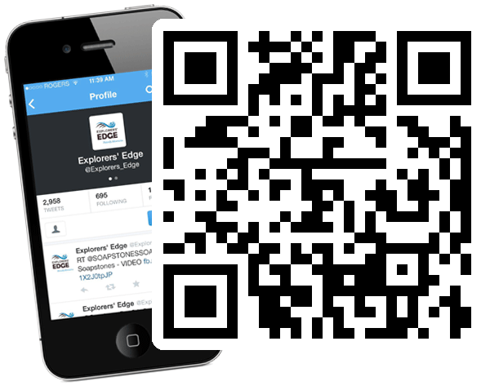
Social Media Marketing
Advertising & Engagement in a Social World
• November 2013 •
E x p l o r e r s E d g e . c a • r t o 1 2 . c a • Twitter Hash tag: #EETownhall

Slide 2
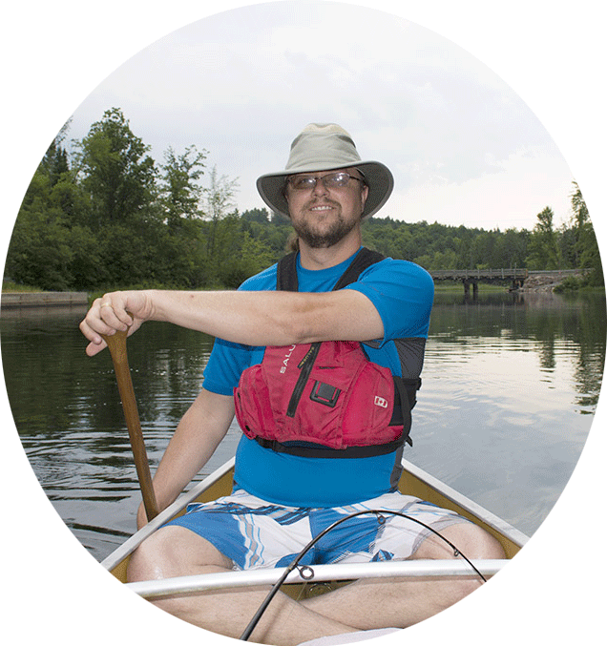
Randy Mitson
Explorers’ Edge – Social Media Manager
  Social Media Workshops
  Tourism Social Media 1:1 Coaching
  Tourism Social Media Audits
  Tourism Media Producer
www.explorersedge.ca • www.rto12.ca
rto12.ca/resources/understanding-social-media/ Email: randy@explorersedge.ca

Slide 3

Today’s Agenda
Traditional vs. Social Marketing
Marketing Evolution
Social Media Sites
Facebook
First Impressions
Building your Fan Base
How to Listen
Social Media Schedule
Producing Engaging Content
Connecting with Explorers’ Edge

Slide 4
Traditional Advertising
Business to Customer Advertising
WORD
OF
MOUTH

Slide 5

Social Media Marketing
Shared Experiences, Customer to Customer Advertising
WORD
OF
MOUTH

Slide 6

Marketing Evolution
M A R K E T I N G 1 . 0
Businesses present their message to an audience.
Print • Radio • Television
M A R K E T I N G 2 . 0
The audience can comment and or review.
Online • Website • Blog
M A R K E T I N G 3 . 0
The audience produces the content.
Blog • Facebook • Google+ • LinkedIn • Pinterest • Twitter • Youtube

Slide 7

Social Media Sites
Hundreds of Social Media Sites
• Choose popular sites
• Focus on one or two
• Facebook
• Twitter
• YouTube
• Pinterest
• LinkedIn
• Google Plus +
• ...Blogs

Slide 8

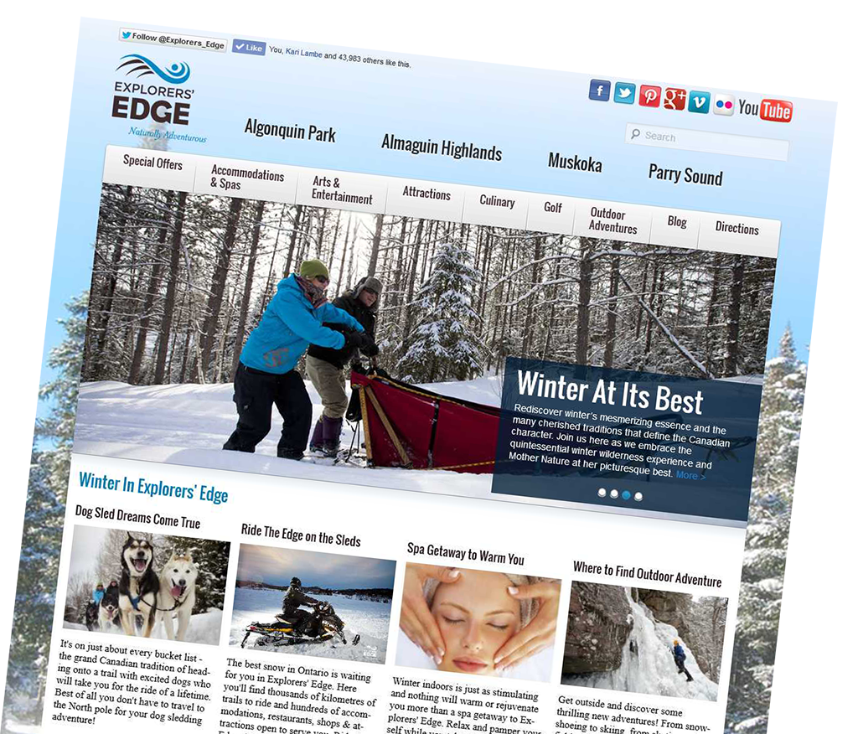
Blogs & Websites
• Blogs and Websites are still the backbone of search results
• A place to display everything about your business; Who, What, Where, When, Contact, Events, Calendar, Services, Rates…
• Blogs have been around since the early days of the web, and are a great way to keep your website fresh with new monthly, weekly or even daily content.

Slide 9

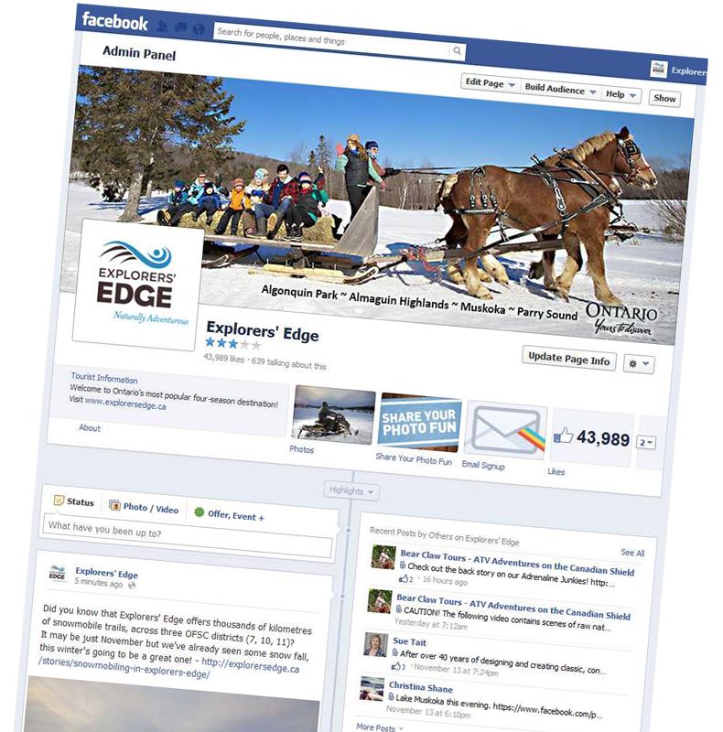
Facebook
• Facebook is the largest social media site online
• 1.19 Billion monthly active users as of September 30th 2013
• 54% of Canadians log into Facebook monthly, 2/3rds of Canadians have Facebook accounts
• 14 Million Canadians (74%) check their news feed every day *
• 13 Million use a mobile device
Your clients are on Facebook!

Slide 10

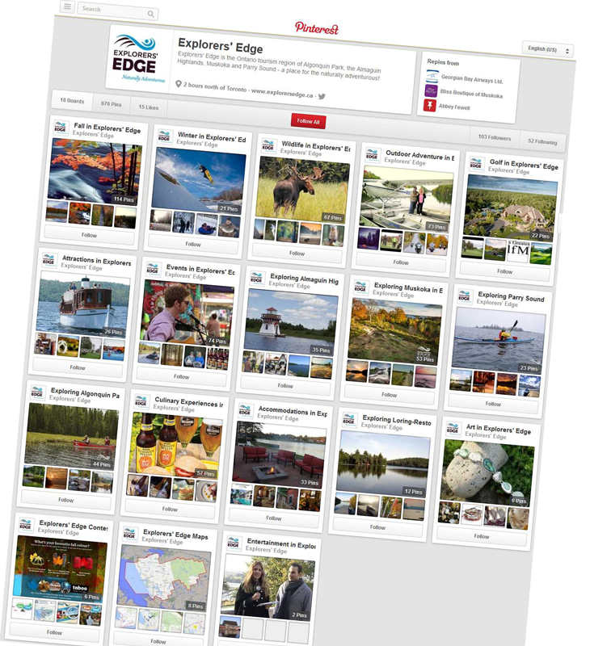
Pinterest
• Pinterest is a pinboard-style photo-sharing website that allows users to create and manage theme-based image collections such as interests, events, vacation destinations and hobbies
• Use it to promote great photos of your destination or event
• People love to share tips and how to do things like recipes
• Remember to create themed boards and follow others too

Slide 11

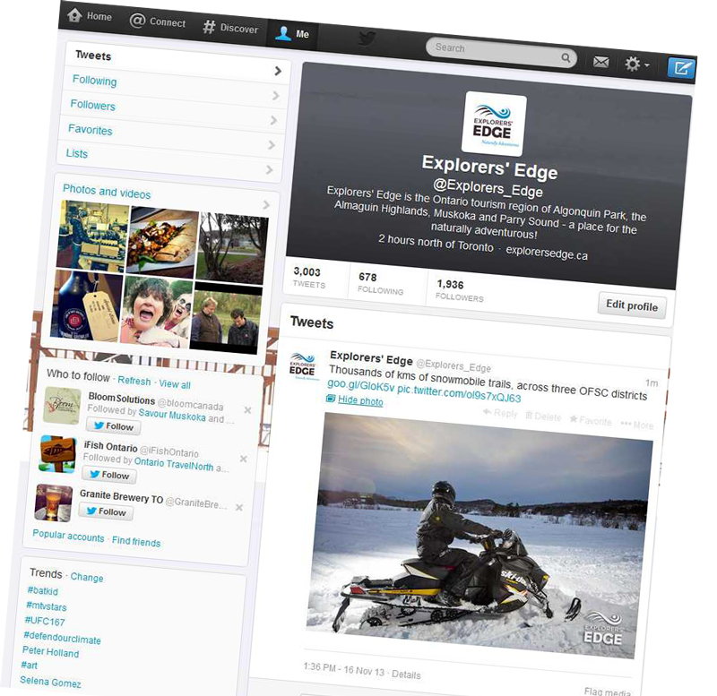
Twitter
• Twitter is a microblogging service that enables users to send and read "tweets", which are text messages limited to 140 characters
• Tweets have a short life span, more like social text messages than posts
• Include multi media with links to webpages, videos or attach photos
• Install Twitter’s mobile app to tweet from anywhere

Slide 12

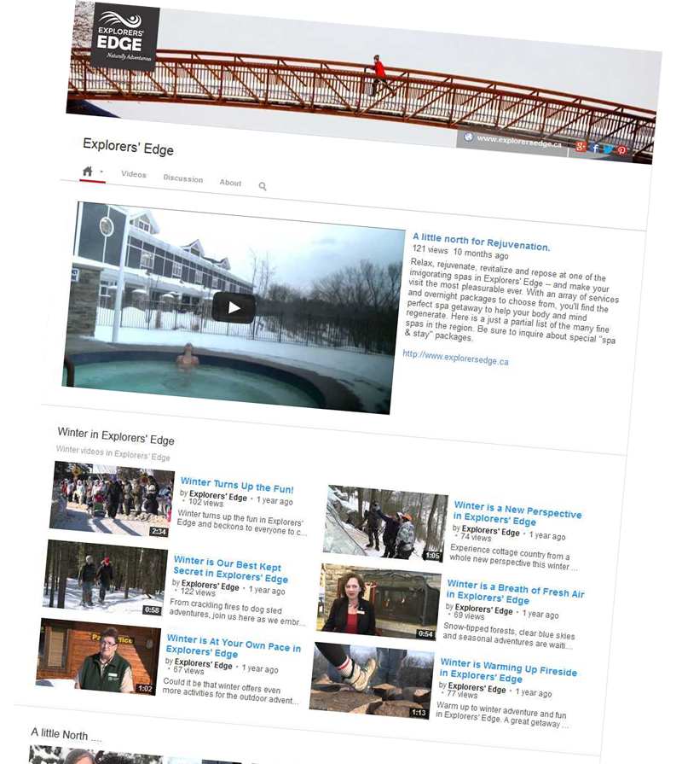
YouTube
• YouTube is a video-sharing and social media site with over 1 billion monthly users
• YouTube is popular in search, second only to Google
• Video is a great way to showcase your business. YouTube offers easy ways to share your video on popular social sites or your website / blog
• “How To” and fun videos are very popular

Slide 13
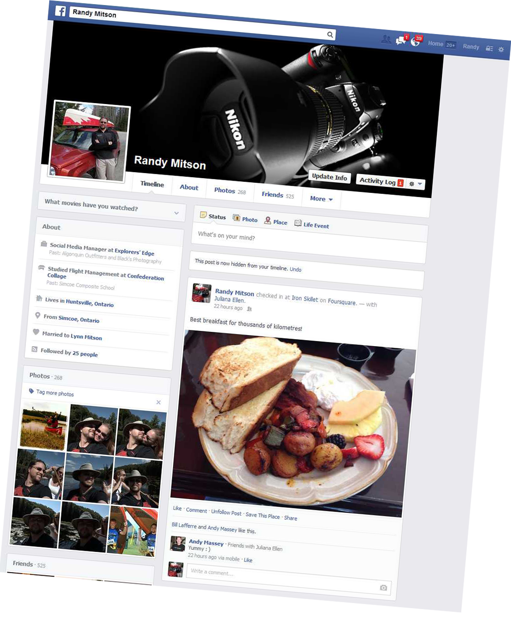
Getting Started / Use it Yourself
• Before using Facebook as a business I suggest getting started with a personal profile
• Lets you understand how Facebook operates before developing your business page
• This allows you to keep your business and personal activity separate
• Allows you to invite your friends to your page once you publish it

Slide 14
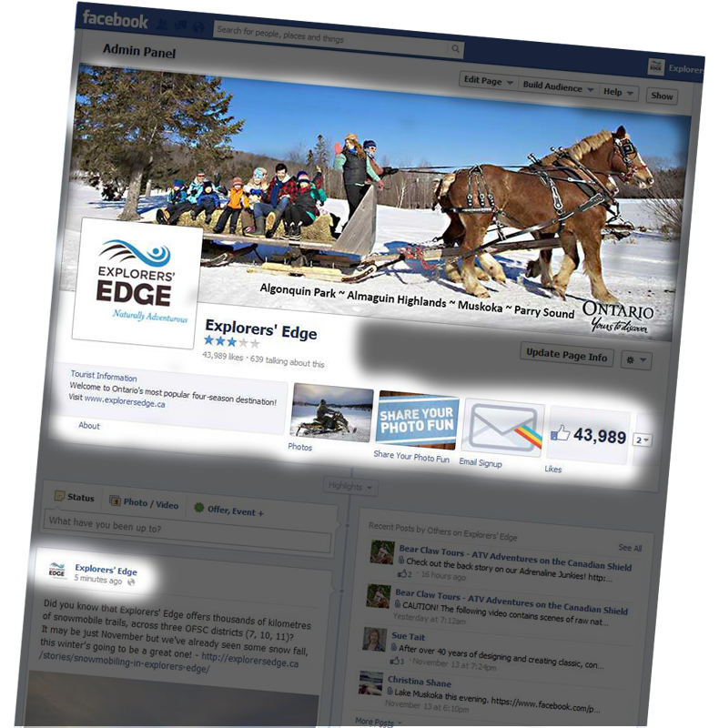
Facebook – First Impressions
• First impressions are very important to getting viewers to “Like” your page.
• Good images for your cover, profile and posts go a long way to attracting new Likes
• Complete the About section for your page and include;
  business description
  address, phone, email
  website & social sites
  map location
• Frequency of posts – look active

Slide 15
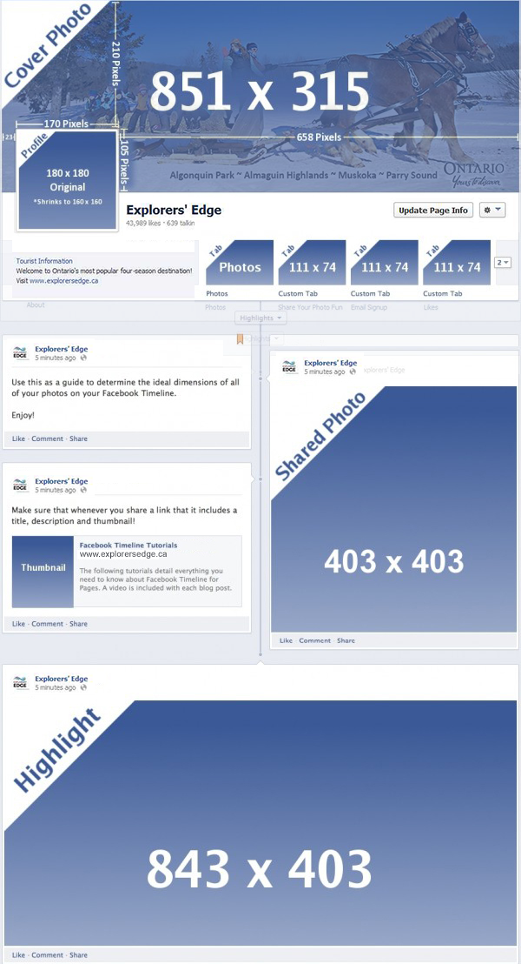
Facebook – Image Sizes
• Cover image is 851 x 316
• Profile image 180 x 180 (square)
• Photo posts 403 x 404
  Images are cropped square
  Reposition Images
  Photos get engagement
  Include text with photo
  Include link to more info
• Highlight photos 843 x 403
• Custom tabs 111 x 74
• App Tab pages 810 wide
• Facebook ad images 100 x 72

Slide 16
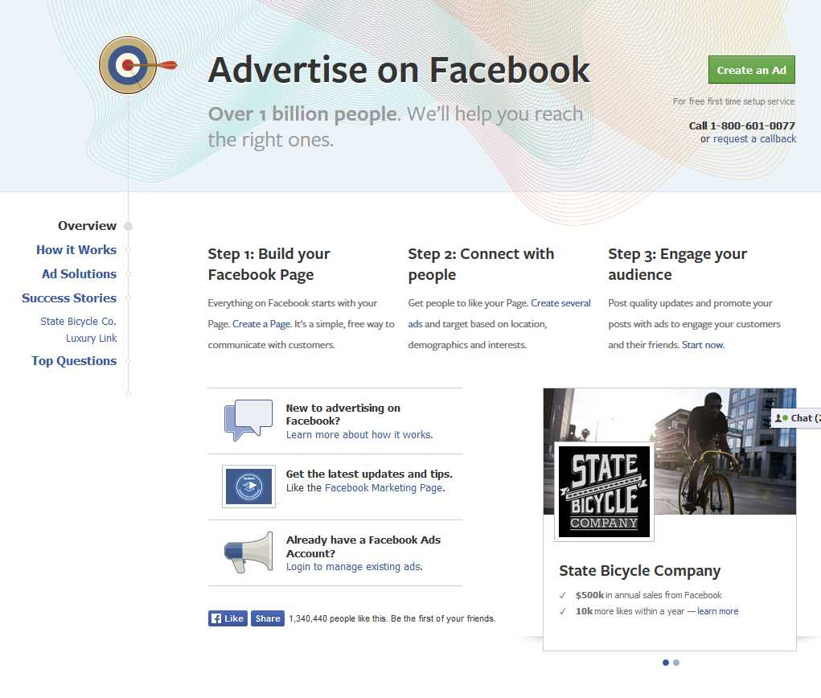
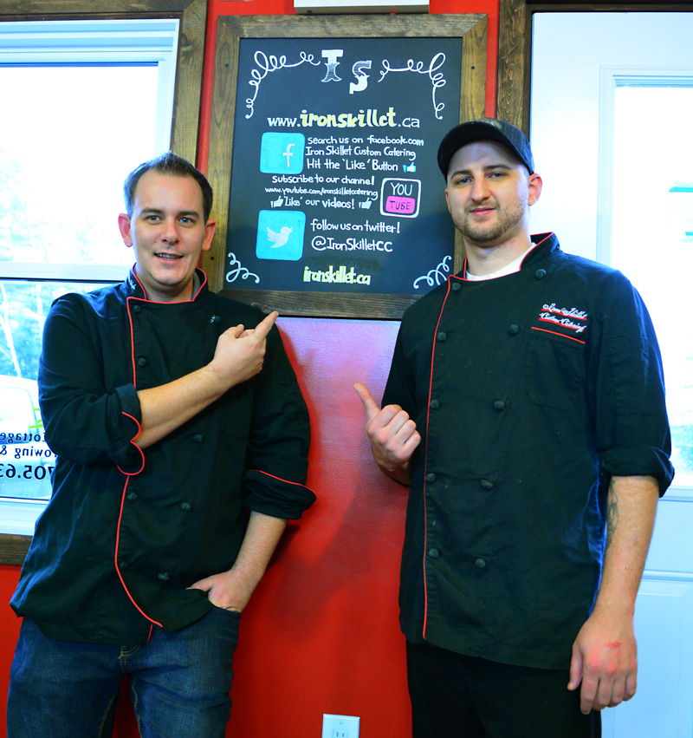
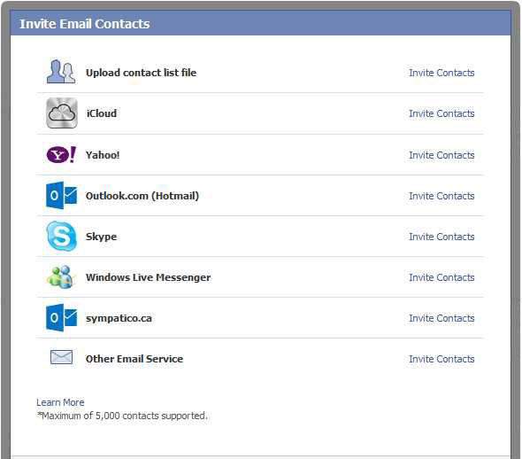

Facebook – 3 Steps to Followers
(0-100 likes ) Invite your friends and family by using Facebook’s Invite Email Contacts.
(101-500 likes) Use the Facebook logo and a link to your page in all print and online media.
  your website & social media
  ads and brochures
(500+ likes) Use Facebook advertising to attract new clients outside of your current lists.
  target current demographics
  locations - city + 50km
  Interests - related

Slide 17
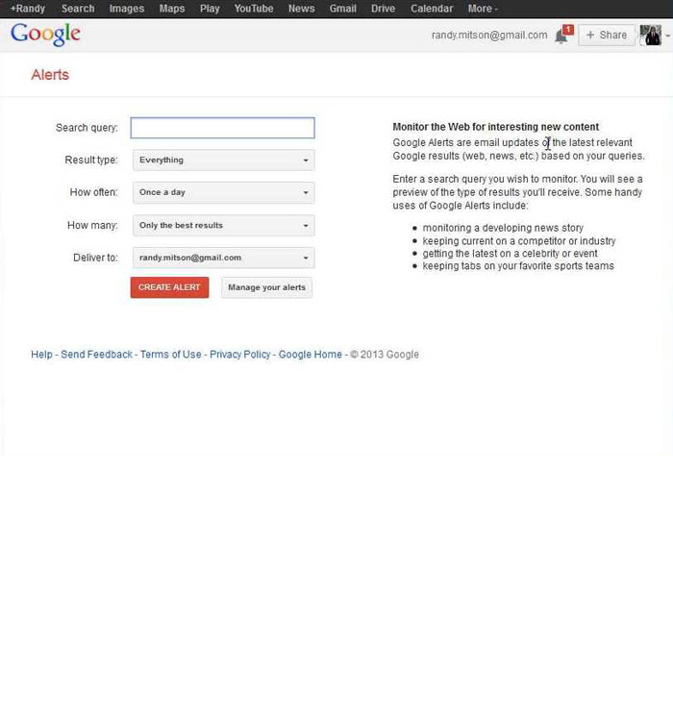
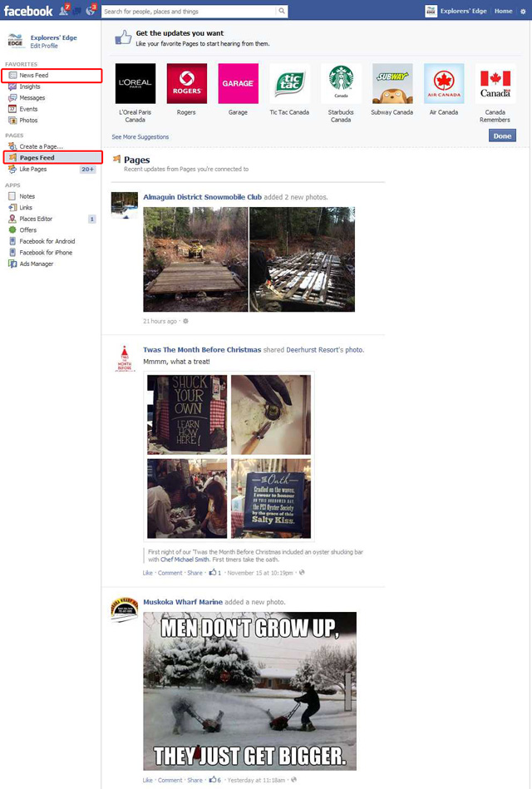
Facebook – Listening
• It’s important to listen to others
• Follow others on social media
• Use your personal and page news feed to view others posts
• Use Google Alerts to monitor online news, websites and blogs about yourself, your interests, others and even the competition.

Slide 18
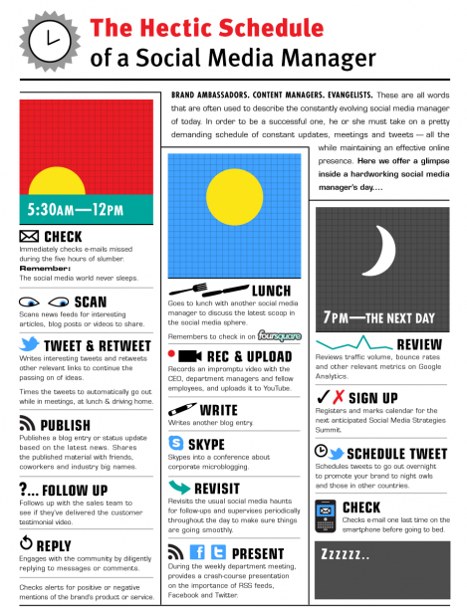
Facebook – Schedules
• Social media marketing doesn’t have to take up a lot of your time. Plan to post at daily prime times
  morning, lunch, evening
• plan to post several times a week or even daily. Best schedules are regular
• Use a service like google calendar to plan and remind you about events and scheduled posts
• start with high level (event) and plan to start talking about it a month out, two weeks, and the week it is
• Use a service like Hootsuite or Tweet Deck to schedule posts for Facebook, Twitter, Google+, etc.

Slide 19
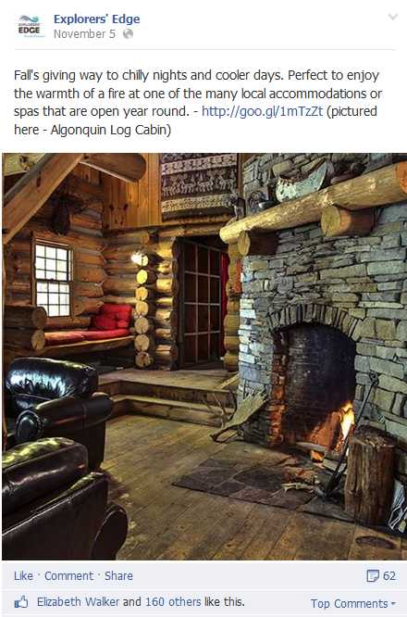
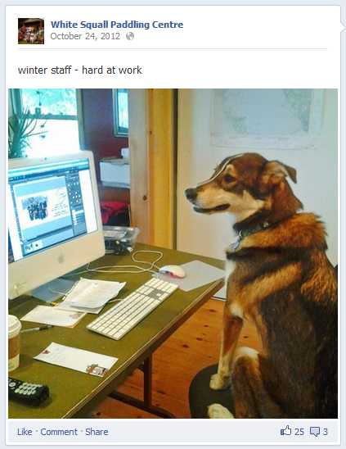
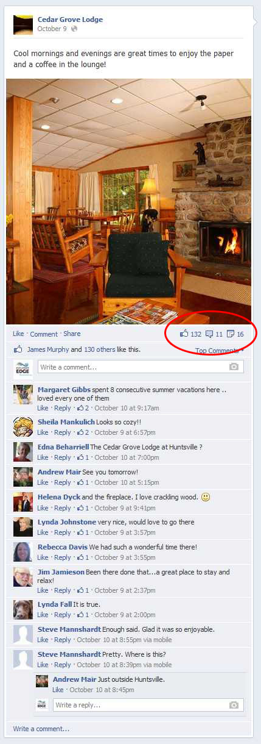
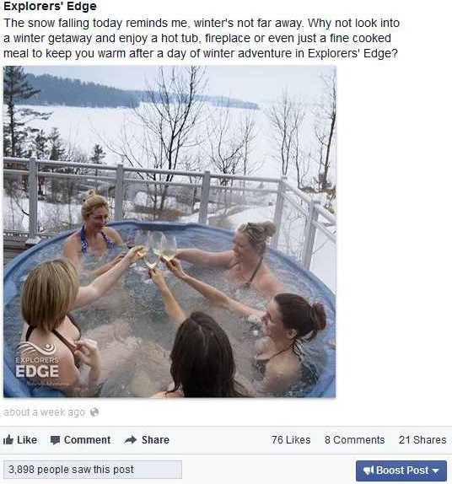
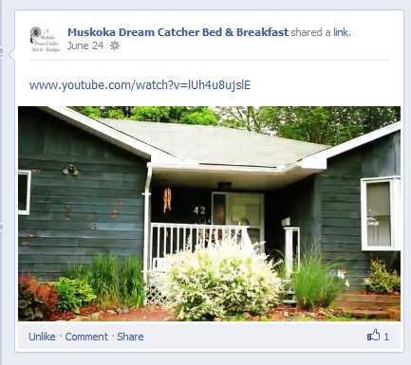
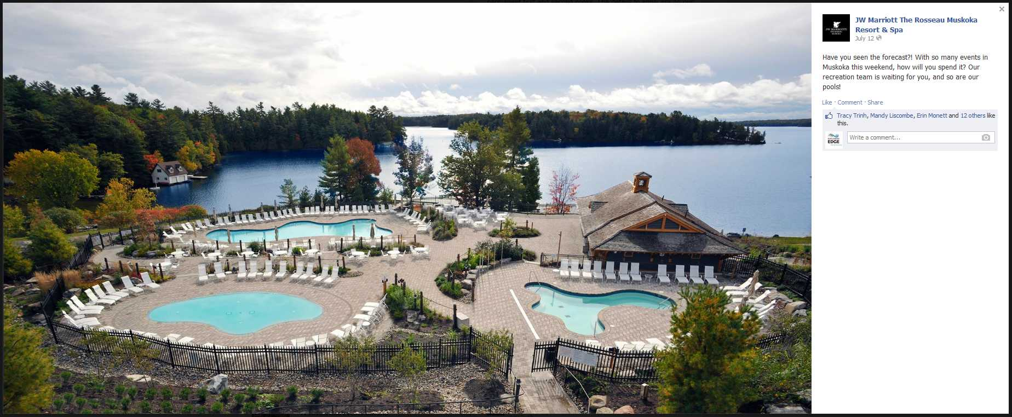
Facebook – Shareable Content
• Focus on creating original content that will be shared by your followers and their friends
• Photos are best for engagment
• Videos get lots of views
• Posts with links back to your website or blog gets you noticed
• Every post should have:
  Media (photo, video)
  Text to describe it
  Link to more information
  Call to action or question to prompt engagement.
• Post great photos not just words

Slide 20
Explorers’ Edge Reach
Explorers’ Edge Facebook Page
44,000+ followers on our Facebook page are made up of:
  Visitors from GTA, Ottawa and South Western Ontario
  63% are women, mostly between 35 and 64 years of age
  Are interested in social events, fine dinning, relaxing getaways, spas, nature, wildlife, adventure, sightseeing, and shopping
  Good posts often reach 3000 – 7000 people organically
Daily Reach: The number of people who have seen any content associated with Explorers’ Edge. (Unique Users) – average of over 90,000 people daily (organic & paid combined reach Jun – Sept)
Posting great content gives you the chance to access this huge base of viewers.

Slide 21
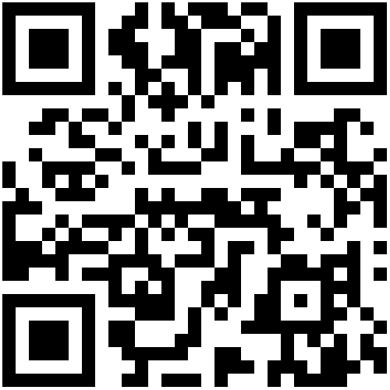

rto12.ca
http://rto12.ca/resources/understanding-social-media/

