Slide 1

Tourism Town Halls
November 13, 2013
Port Carling, Parry Sound, Algonquin Park, Sundridge & Gravenhurst

Slide 2
Tourism Town Halls
Tourism Model
Current Program
Collaboration
Moving Forward

Slide 3
Regional Tourism Model

Slide 4
Regional Tourism Model
40 Million Allocation
  1.498 million (Halliburton Highlands & Kawartha)
  Base Funding, Proportional Funding, Partnership Funding
5 Pillars
  Workforce Development, Investment Attraction, Tourism Product Development, Marketing, Governance (Industry Relations)
  Transfer Payment Agreement
    Quarterly Reports
    Progress Report and Final Report

Slide 5
Resources & Partnership
Regional Tourism Organization 12
  www.rto12.ca
Ministry of Tourism Culture and Sport
  http://www.mtc.gov.on.ca
  Tourism Development Fund
  Celebrate Ontario
  Ontario Music fund
Ontario Tourism Marketing Partnership Corporation
  http://www.tourismpartners.com
FedNor Industry Canada
  www.fednor.gc.ca

Slide 6
Current Programming

Slide 7
Current Programming
Marketing
    Fall Blue & Winter Turns up the Fun
Transacting
    Signature Programs – Fuel and Fun & Explore the Edge
Research
    Tourism Indicator Framework

Slide 8
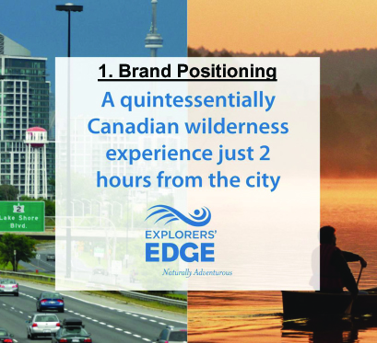
Marketing
Engage Multiple Operators
Create new audiences
Change Perceptions
Build Shoulder Seasons

Slide 9


Marketing
2012/2013
Summer 2012 – Facebook Audience
The tactical objective of the summer 2012 campaign was to build awareness and audience for EE
Fans as of June 25 - 10,146 * Total Fans at campaign end 29,136
Fall 2012 – Fall Blue Campaign
The goal of the fall campaign was to differentiate the region during a popular travel time by having more colours than any where else in the region.
Winter 2013 – Winter Turns Up the Fun
The goal of the winter campaign was to change the perception that there is nothing to do in our region in the winter.

Slide 10
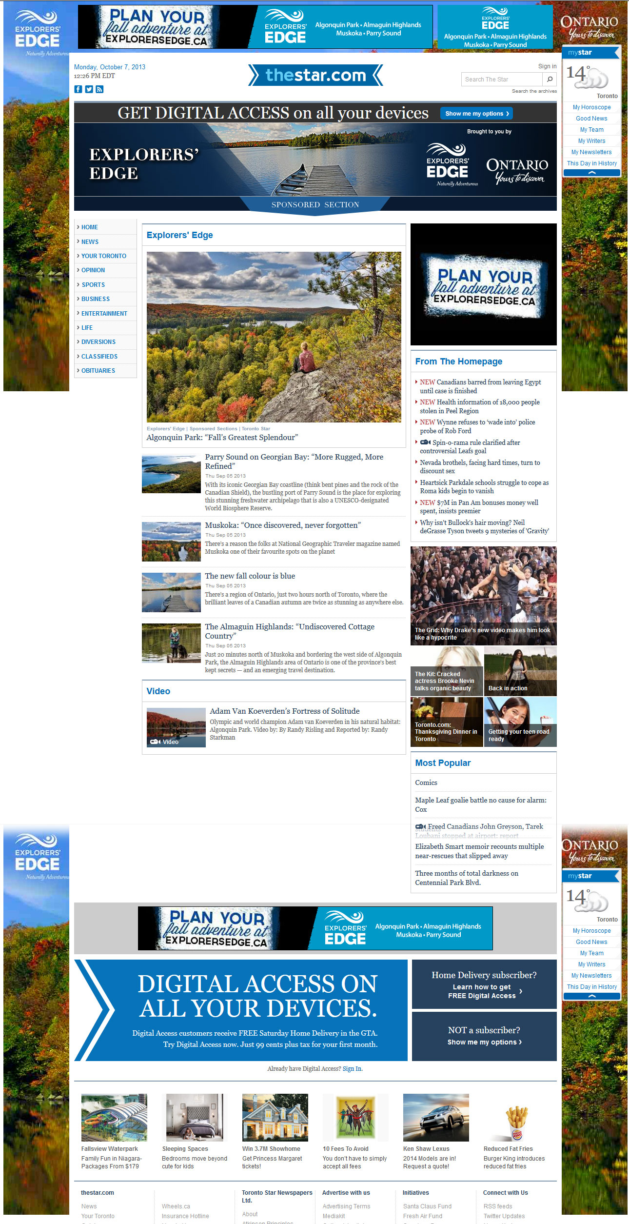
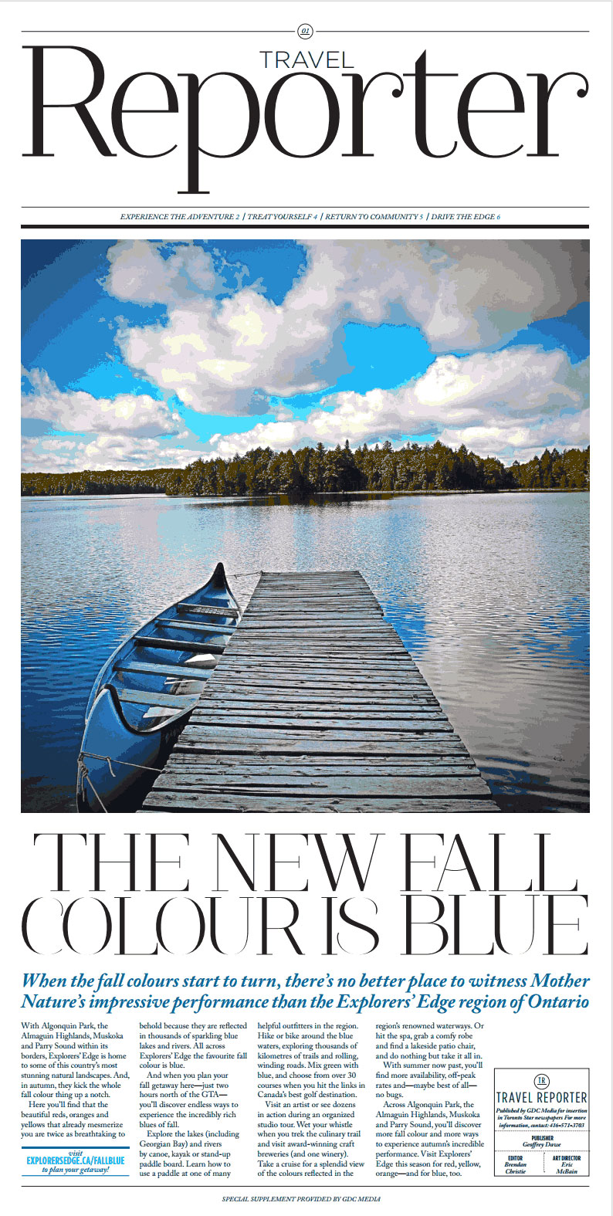
Fall 2013

Slide 11
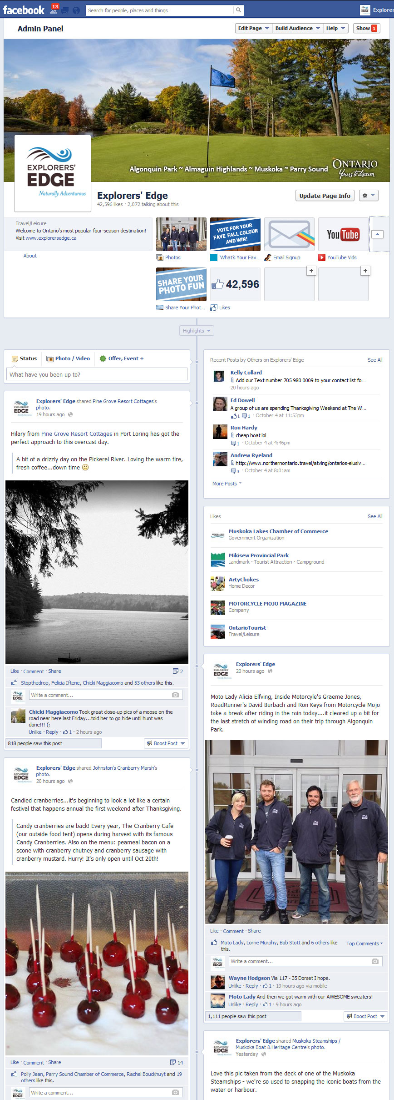
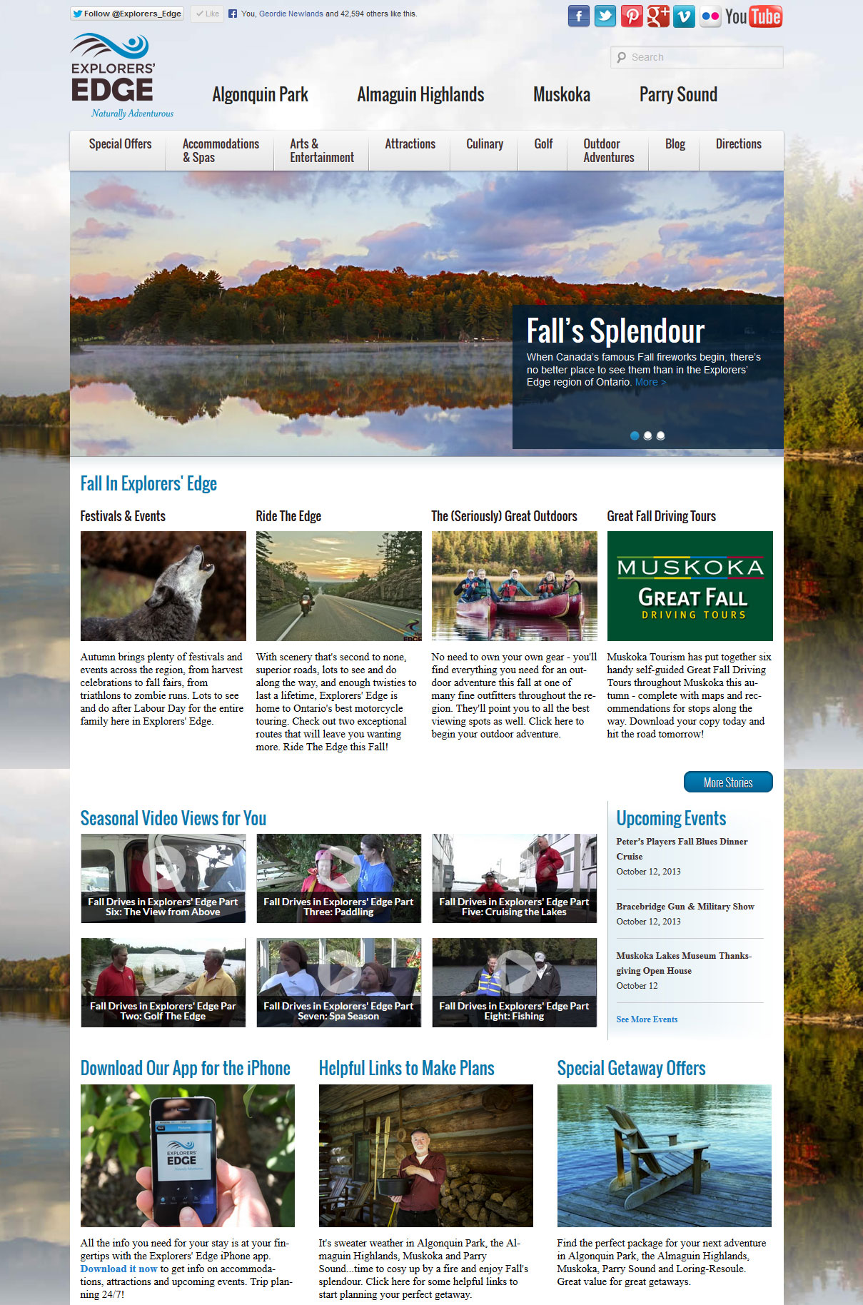
Facebook and Website
Facebook
44,000 Fans
Supplement Marketing with contests, sponsored stories, and operators coupon tab
Website
2013 to date has already exceeded total unique visits overall for 2012-2013
Operator Database
Special Offers, Operator Database and Blogs are top three clicks
74,000 visits in 6 weeks

Slide 12
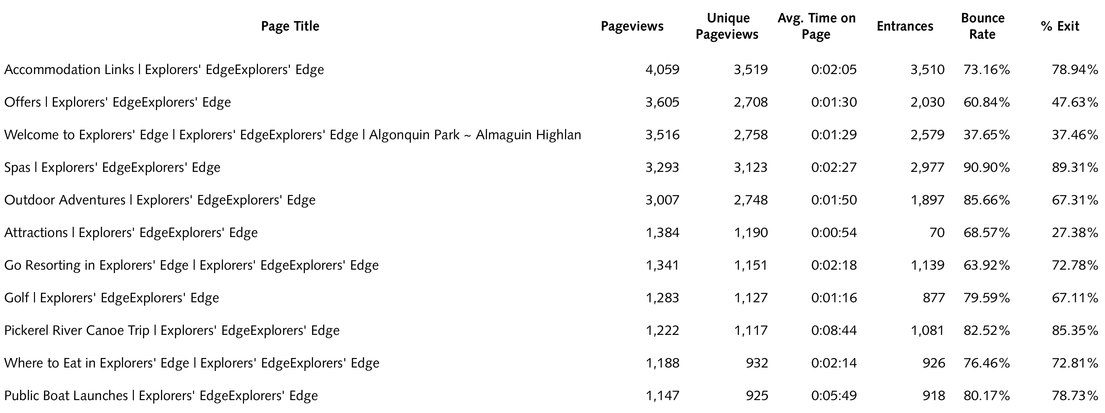
Explorersedge.ca Traffic
Top 10 Content Pages

Slide 13
Title | Page Title | Impressions | Clicks
Bala Cranberry Festival | Head to Muskoka Oct. 18-20 to celebrate the annual harvest at the Bala Cranberry Festival. | 3,518.00 | 126.00
Summer Birding In Muskoka | A birding experience in Muskoka is totally unplugged – come listen to real songs of summer | 136,536.00 | 63.00
Explorers' Edge | Great news for Fall travelers!! The deadline to book a Fall getaway in the Explorers'… | 10,659.00 | 101.00
Fall Fuel & Fun! | Get $50 gas card and $50 cash for a Fall getaway to Explorers’ Edge! | 196,857.00 | 2,240.00
Cottage Country Festivals | Celebrate everything from ribs to crafts to motorcycles! | 289,942.00 | 109.00
Parry Sound Islands | Experience them up close. Find out how to get there and why you should go! | 462,721.00 | 188.00
Parry Sound Islands | Explore the islands of Georgian Bay with some great Parry Sound guides. | 425,261.00 | 195.00
Glamping on Georgian Bay | Visit Georgian Bay Islands National Park's new cosy cabins. | 320,421.00 | 11,361.00
Girlfriends’ Getaway | Rock out with Pat Benatar and your BFFs at Huntsville’s Girlfriends’ Getaway Weekend. | 2,585.00 | 89.00
Craft Brewers in Muskoka | Don’t miss Griffin Session Muskoka this weekend: craft beer, local food, bearded musicians | 28,397.00 | 323.00
Group of Seven Outdoors | Tour Muskoka’s Group of Seven Outdoor Gallery this fall. | 30,501.00 | 746.00
Halifax to Parry Sound | Follow Brian James of Symphony Nova Scotia on his motorcycle ride to Parry Sound. | 40,051.00 | 692.00
Halifax to Parry Sound | Follow Brian James of Symphony Nova Scotia on his motorcycle ride to Parry Sound. | 84,674.00 | 50.00
Muskoka Fall Drives | Take one of the Great Fall Driving Tours from Muskoka Tourism. | 317,877.00 | 190.00
Muskoka Fall Studio Tour | Canada’s original Fall studio tour is back for its 35th year. | 20,936.00 | 532.00
The Park To Park Trail | Explore the multi-use trail that connects two iconic Ontario parks in Explorers' Edge! | 365,803.00 | 8,686.00
Pickerel River Canoe Trip | Discover a little known paddlers' paradise in beautiful Loring-Restoule, Ontario. | 969,250.00 | 274.00
Pickerel River Canoe Trip | Discover a little known paddlers' paradise in beautiful Loring-Restoule, Ontario. | 2,076,013.00 | 828.00
Muskoka Pride Week | Celebrate diversity and inclusion at Muskoka Pride Week events! | 40,241.00 | 1,147.00
Explorers' Edge | Discover Road Trip Odyssey: Halifax to Parry Sound, as Brian James of Symphony Nova Scotia… | 24,232.00 | 745.00
Explorers' Edge | You've just got to get out on the water this weekend and discover the Georgian Bay Biosphere Reserve Islands… | 13,371.00 | 245.00
Parks in Explorers’ Edge | Help Randy from the regional tourism organization pick a Provincial Park to explore next! | 29,453.00 | 16.00
Go Resorting | Go Resorting this summer in Algonquin Park, Almaguin Highlands, Muskoka and Parry Sound. | 128,043.00 | 2,140.00
Resorts Of North Muskoka | Independently-owned resorts provide traditional cottage experience. | 90,120.00 | 2,159.00
Ride The Edge | Tour the best motorcycle routes in Ontario. | 122,306.00 | 4,042.00
Screaming Heads | Visit the Almaguin Highlands to see the Screaming Heads | 229,405.00 | 4,518.00
Stone Skipping Contest | Undiscovered cottage country is just a stone’s throw away in the Almaguin Highlands. | 13,755.00 | 194.00
Muskoka Walleye Fishing | Bill Anderson of Muskoka Outdoors shares how to hook one this summer. | 7,051.00 | 234.00
Muskoka’s Wild Side | Canadian wilderness is closer than you think. Go wild in cottage country with Hap Wilson. | 90,903.00 | 1,450.00
Sweater Weather Tour | Visit the Almaguin Highlands Oct 4-6 for Sweater Weather Tour specials! | 7,500.00 | 81.00

Slide 14
Explorersedge.ca
Traffic
Top 25
Outbound Link
URL | Total Events | Unique Events
http://www.discovermuskoka.ca | 311 | 276
http://www.gbcountry.com | 223 | 215
http://www.facebook.com | 186 | 163
http://www.algonquinpark.on.ca | 184 | 178
http://www.bbcanada.com | 75 | 46
http://www.resortsofontario.com | 73 | 66
http://www.vacationlandontario.com | 73 | 70
http://www.deerhurstresort.com | 72 | 69
www.adventurelodge.com/ | 70 | 69
http://almaguin.on.ca | 69 | 67
http://www.bbmuskoka.com | 63 | 57
http://www.couplesresort.ca | 63 | 61
http://www.youtube.com | 58 | 57
http://www.bayviewwildwood.com | 56 | 54
http://www.ontarioparks.com | 52 | 37
http://www.tabooresort.com | 47 | 43
http://santasvillage.ca | 45 | 44
http://www.cedargrovecamp.com | 40 | 40
http://www.oldmirrorlodge.ca | 39 | 37
algonquinboundinn.com/index.html | 38 | 36
www.ahmiclakeresort.com/ | 38 | 38
http://tourismbracebridge.com | 37 | 29
http://www.voyageurquest.com | 36 | 35
www.AlgonquinEcoLodge.com | 36 | 34
www.sherwoodinn.ca/en/spa/ | 33 | 31
http://www.parrysoundbb.com | 31 | 27
http://ferngleninn.on.ca | 30 | 29

Slide 15



Signature Programs
Fuel and Fun
Spring 2012 – 118 Bookings vs Spring 2013 - 240 bookings
Fall 2012 – 395 bookings
Of those that registered:
79% sited it influenced there decision to travel to Explorers’ Edge
40% sited it was there first time North

Slide 16
Research:
Tourism Indicator Framework
  Brand Health
    Assess key brand health metrics for Explorers’ Edge
    Awareness, Intention to visit and perceptions
  Program Metrics
    Measure and monitor marketing and Signature Programs
  Visitor Exit Survey
    Gain a better understanding of what motivates people to visit the region
  Business Index
    To provide a cross section of actual business performance metrics the sum total of which provides insight into the health of the tourism industry
    HST, Occupancy, Campground, Attraction, Golf etc.

Slide 17
Collaboration

Slide 18
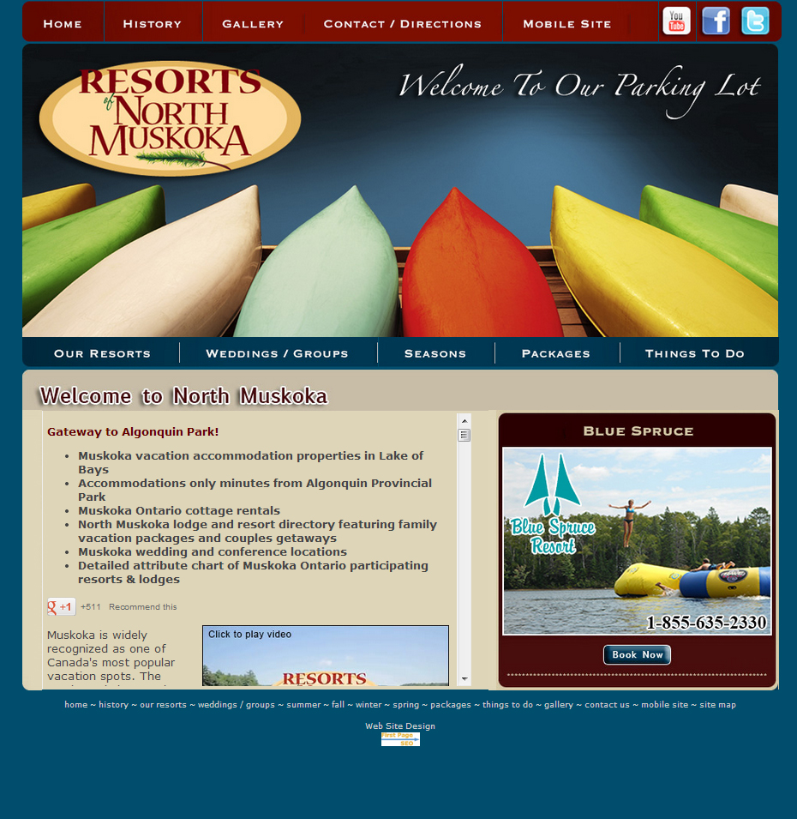
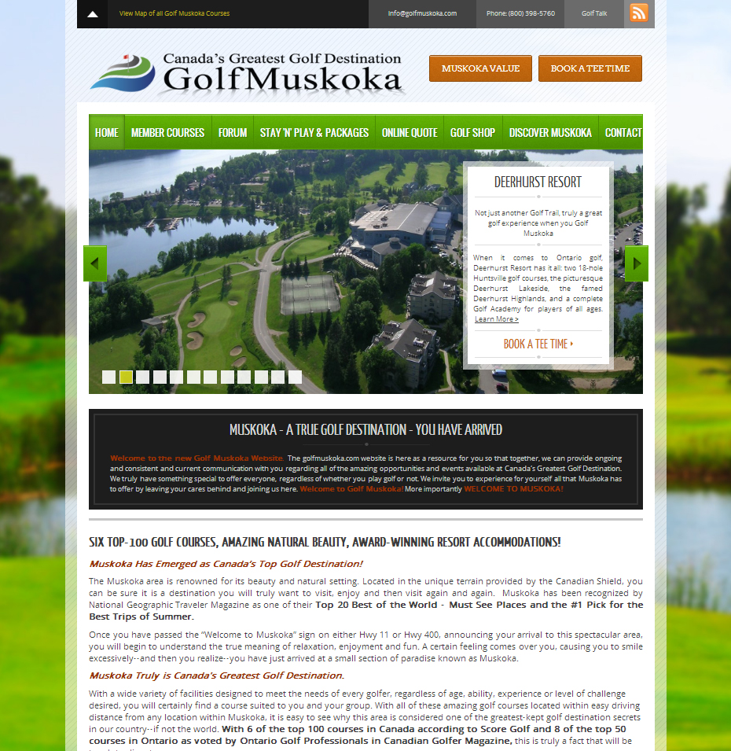

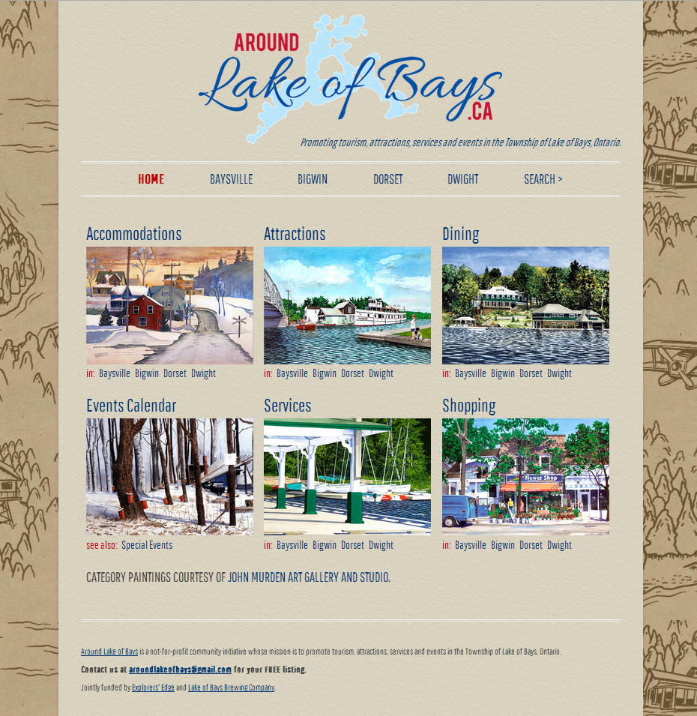
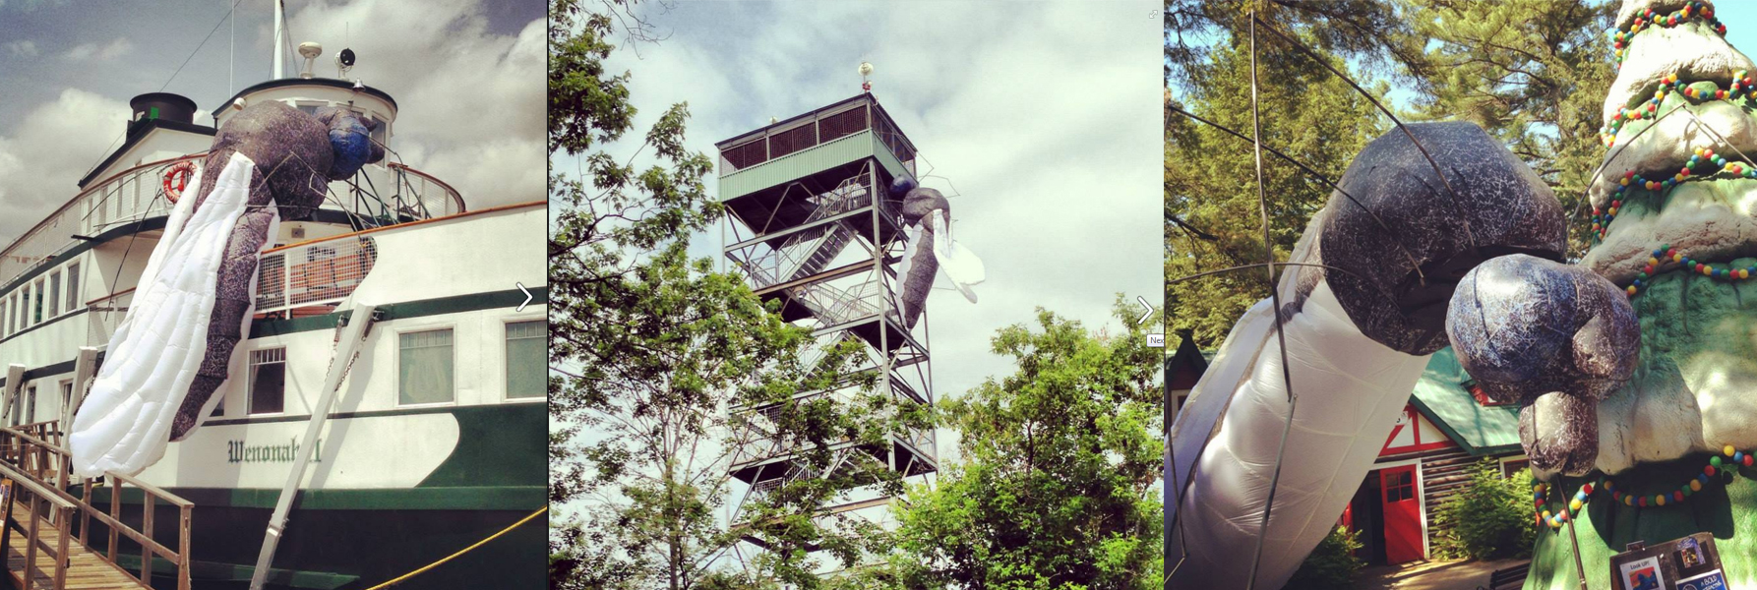
Partnership
Program
Santas Village and Muskoka Fleet
Resorts of North Muskoka
Stockey Centre – Town of Parry Sound
Lake of Bays Brewery
Tri-Muskoka
Town of Bracebridge
Golf Muskoka
JW Marriot Resort and Spa
Muskoka Festival of the Arts
Muskoka Chautauqua
Business Plans were excepted in January 2013.
Committee of the board reviewed the plans.
Put into the marketplace April 1, 2013
Align with strategy:
Building shoulder season
Changing perceptions
Engaging multiple operators
Creating new audiences

Slide 19
Tourism Product Development Fund
Park 2 Park Trail
Town of Parry Sound
Canadore College
Friends of Algonquin Park
Arrowhead Provincial Park
Huntsville Chamber of Commerce
Georgian Bay Country
Port Loring / Restoule Business Association
Gravenhurst Chamber of Commerce
SAVOUR Muskoka
Pilot Project 2012/2013
Capacity to develop Tourism Product
MTCS Deliverable
Pilot Project has been extended for 2013/2014

Slide 20


Almaguin Highlands
Tourism operators participated in brainstorming session and surveys in February 2013 and June 2013.
Strategy was developed in July 2013 to
1) position Almaguin Highlands as "undiscovered cottage country" and to
2) create shoulder season events that tourism operators across ENTIRE region can benefit from and participate in.

Slide 21
Loring
Restoule
Tourism operators participated in brainstorming session and surveys in January 2013 and March 2013
Strategy was developed in April 2013 to
1) position Loring Restoule as “off the grid as nature intended" and to
2) Create a tourism portal that included engaging content while highlighting unique attribute for tourism operators across ENTIRE region.

Slide 22
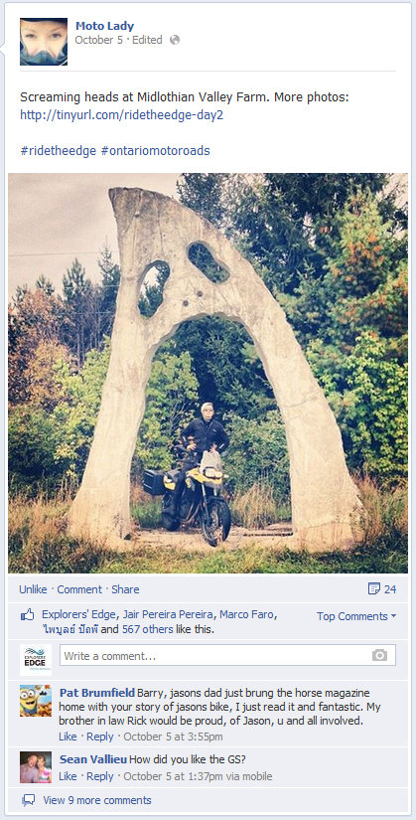
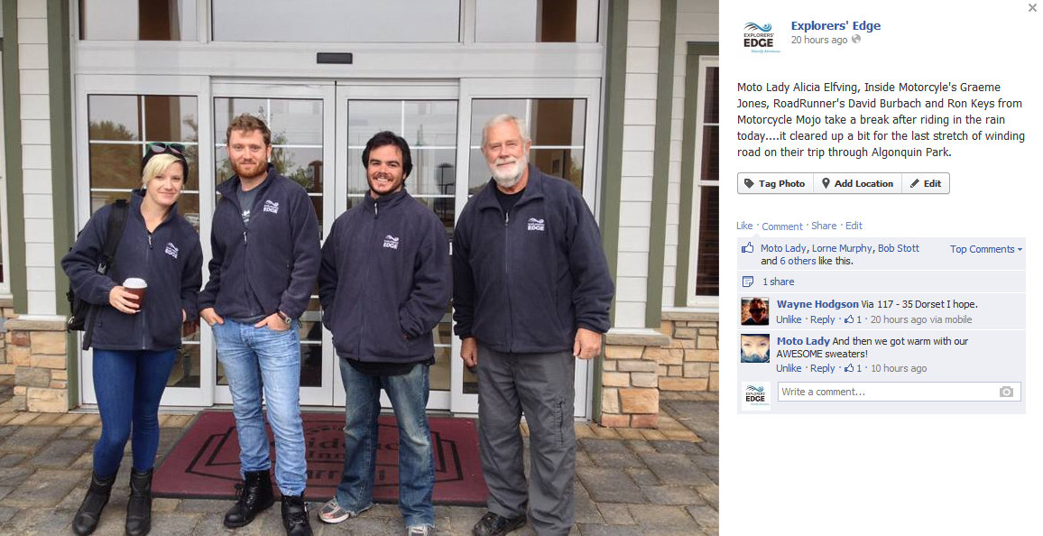
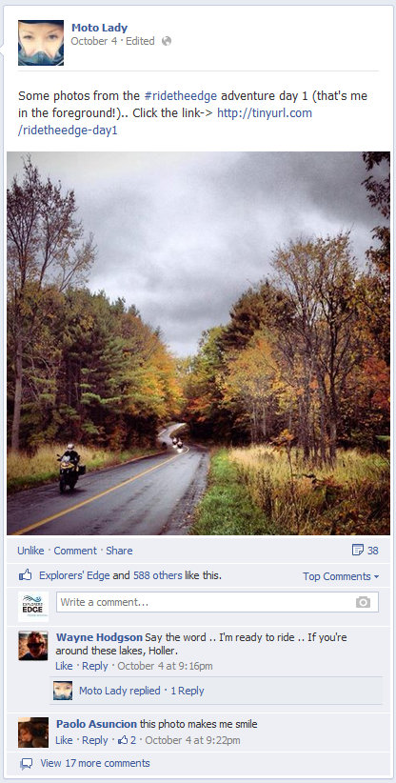
Strategic Collaborations
Ride the Edge
Northern OTMPC
Product Development
FAM Tour
Sub-regional product – Sweater Weather Tour
Northern OTMPC
Ride the Edge
Outdoor Journal Radio
OTMPC
TIPP, Fall Blue
FedNor
Port Loring / Restoule

Slide 23
Moving Forward

Slide 24
Destination Development Plan
Revising the Destination Development Plan
  Updated Mission, Vision and Mandate
Revising the Destination Development Plan
Collaboration is Key
In-house Control Optimal for Campaigns
Expert Support
Best Work → Consider the Visitor
Strategy & Process

Slide 25
Guiding Principals 2014-2017
● Leverage strategic collaborations to develop strategies, programs, products and communications that significantly increase the volume of visitors to the Explorers’ Edge Region.
● Use strategy and process as guiding beacons to ensure the success of the organization and its initiatives.
Operating Principles
◦ Change perceptions
◦ Build new audiences
◦ Increase four season business
◦ Leverage significant strategic partnerships
◦ Engage multiple operators

Slide 26
2014 - 2017
Organization
  Consumer Focused
  Engagement & Outreach
  Collaboration
Awareness & Understanding
  Tourism Indicator Framework
  MTCS Research Unit

Slide 27
Organizational Involvement
Board of Directors
Committees
Membership

Slide 28
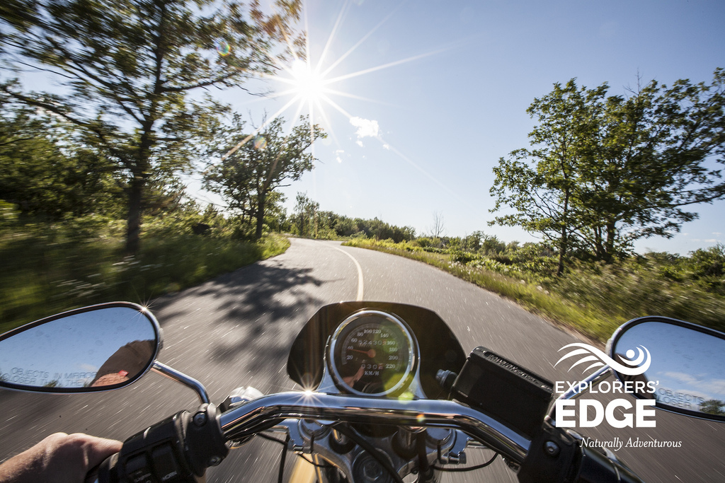
Questions

