Slide 1

Marketing Committee
Fall / Winter Update
November 27, 2013

Slide 2
Marketing
2013 Fall Blue

Slide 3
Overview - Evolving Fall “Blue”
Promoting content to educate prospective visitors
spectacular fall colour that sets Explorers Edge apart from other destinations in Ontario – Blue.
These targets have the following implications for media:
Younger consumers are voracious online consumers, and the Fall Blue idea (due to its visual nature) is well suited to this medium
Older consumers, while big users of digital and social media, are still avid users of print media. Again, the Fall Blue idea is well suited to this medium
Tactical targets can be reached online using SEM as well as display ads targeted by keywords (for example, having the Fall Blue ads appear on hiking and motorcycle enthusiast sites).
Connected Explorers * Outgoing Mature * Couples Mellow Vacationers * Nature Lovers

Slide 4
Objectives
The primary objective was to drive “qualified” prospects to ExplorersEdge.ca.
Specifically, 33,000 visits to the site over the campaign period.
In addition, there were important subsidiary objectives:
Drive engagement with the content on EE.ca
Drive visitors onwards to operator websites

Slide 5
Placement |  | August |  |  |  | September |  |  |  |  | October
 |  | 5 | 12 | 19 | 26 | 2 | 9 | 16 | 23 | 30 | 7 | 14 | 21 | 28
Search Engine Marketing (Fuel & Fun)
Search Engine Marketing (Fall Blue)
Star Media Group | thestar.com - Custom Section Sponsorship |  |  |  |  | Sept. 5 - Oct. 14
 | thestar.com LIFE Hub Takeover: Gatefold
 | thestar.com NEWS Hub Takeover: Gatefold
 | NYTimes - Travel (728x90, 300x250) |  |  |  |  | Sept. 5 - Oct. 14
 | Olive Vertical - Lifestyle (728x90, 300x250) |  |  |  |  | Sept. 5 - Oct. 14
 | CPC - Across the network (728x90, 300x250) |  |  |  |  | Sept. 5 - Oct. 14
 | thestar.com - News & Life (added value) (728x90, 300x250) |  |  |  |  | Sept. 5 - Oct. 14
 | Travel Reporter - 8-page insert
 | 1/2 page ad in GTA section of print edition (added value)
Net Margins |  |  |  |  |  | Sept. 3 - Oct. 14
Facebook |  |  |  |  |  | Sept. 3 - Oct. 21
CARP e-Newsletter (Fuel & Fun)
Google Adwords
Facebook Ads & Contest App
Banner Ads
NetMargins
Toronto Star
Sponsored online Content Hub
Online banner ads
Printed Travel Reporter Supplement
1/2 page ad in newspaper
CARP eNewsletter
Fuel and Fun

Slide 6
Results

Slide 7
Focus for Impact and Efficiency
The goal is to have the campaign drive approximately 33,000 visitors to ExplorersEdge.ca
250% increase over Fall 2012.

Slide 8
September 2nd – October 21, 2013
80,206 visitors to Explorers’ Edge
2.4x campaign objective
250% increase in site visits over 2012
66,453 unique visitors vs 18,546 in 2012 (258% increase)
135,293 page views vs 51.170 in 2012 (164% increase)
Average Visit Duration & Page Views Per Visit
Decrease 36% & 25% respectively
Facebook
Drove the Greatest Volume – 28% of all Traffic
Google AdWords 26% - NetMargins 20% - The Star 13%

Slide 9
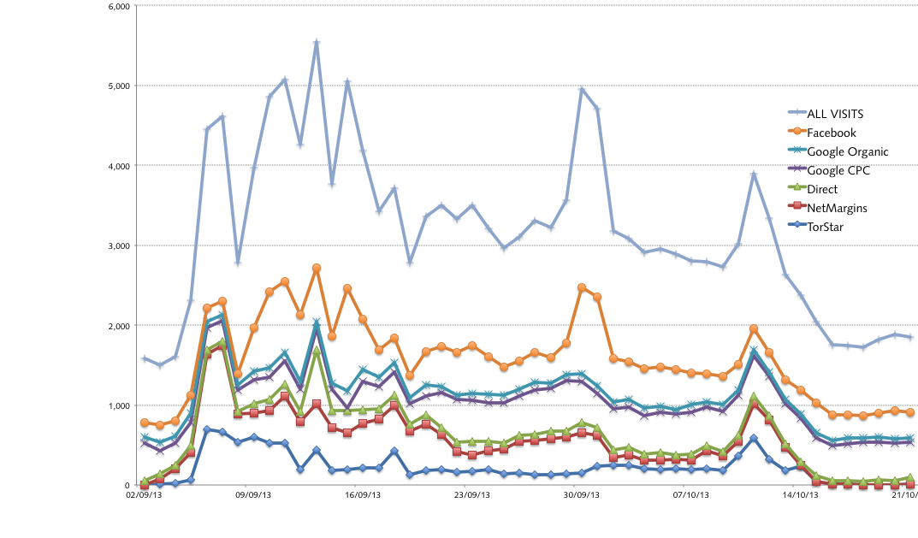
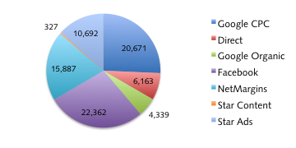
Visits by source
Visits by day

Slide 10
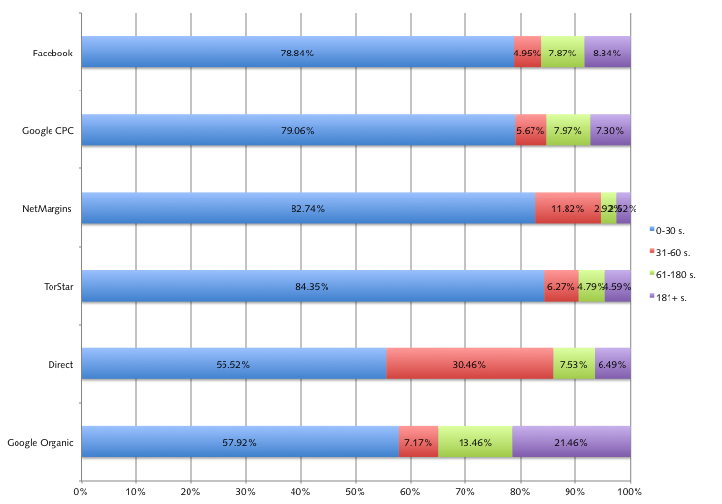
Of the “paid” tactics employed in the campaign, Google Adwords and Facebook delivered the highest quality visitors
Google Organic 0:03:17
Direct traffic 0:02:41
Google CPC 0:01:07
Facebook 0:01:07
TorStar 0:00:46
NetMargins 0:00:33

Slide 11
Overall, during the campaign period
11,434 visitors were referred
DMO and other regional websites
This represents 14% of all visitors

Slide 12
URL | CLICKS
pc.gc.ca | 1,289
discovermuskoka.ca | 491
algonquinpark.on.ca | 436
gbcountry.com | 357
adventurelodge.com | 314
parktoparktrail.com | 260
facebook.com | 244
almaguin.on.ca | 190
algonquinboundinn.com/index.html | 136
beauview.on.ca | 130
ahmiclakeresort.com | 122
vacationlandontario.com | 115
cloverleafcottages.ca | 110
algonquinecolodge.com | 104
yoyageurquest.com/algonquin-lodge.php | 104
youtube.com | 100
mukokadreambedandbreakfast.com | 97
40baystreet.com | 87
deerhurstresort.com | 83
springlakeresort.net | 81
Top
Twenty
Referrals

Slide 13

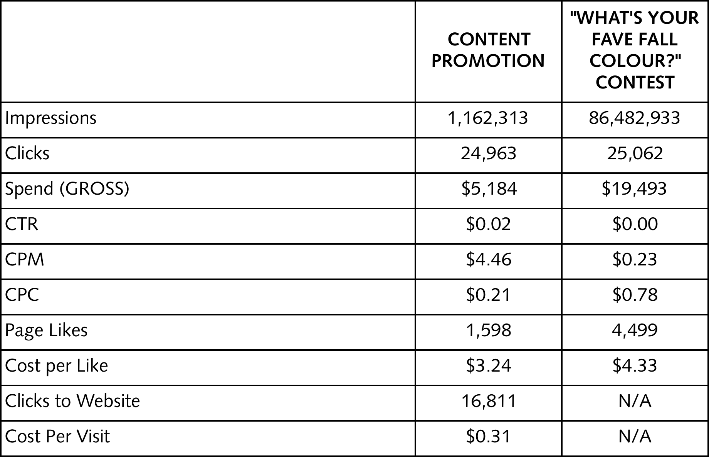
The content promotion campaign was setup to drive engagement with Explorers’ Edge online content. These ads generated almost 25,000 clicks, of which 16,811 went to EE.ca
The contest app promotion was setup to drive traffic to the Explorers’ Edge contest app and to generate page likes. It generated just over 25,000 clicks and almost 4,500 page likes

Slide 14
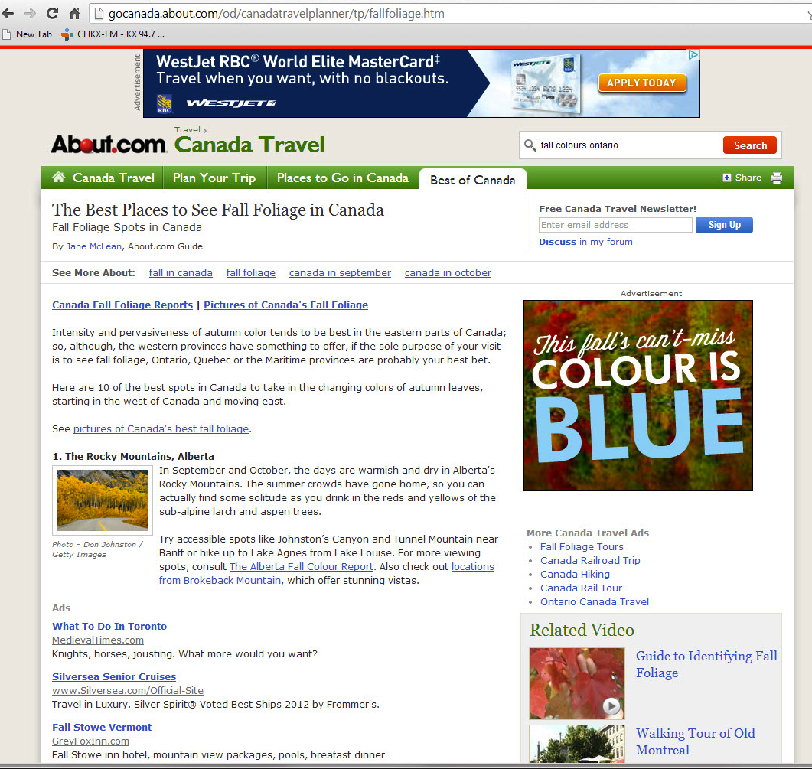
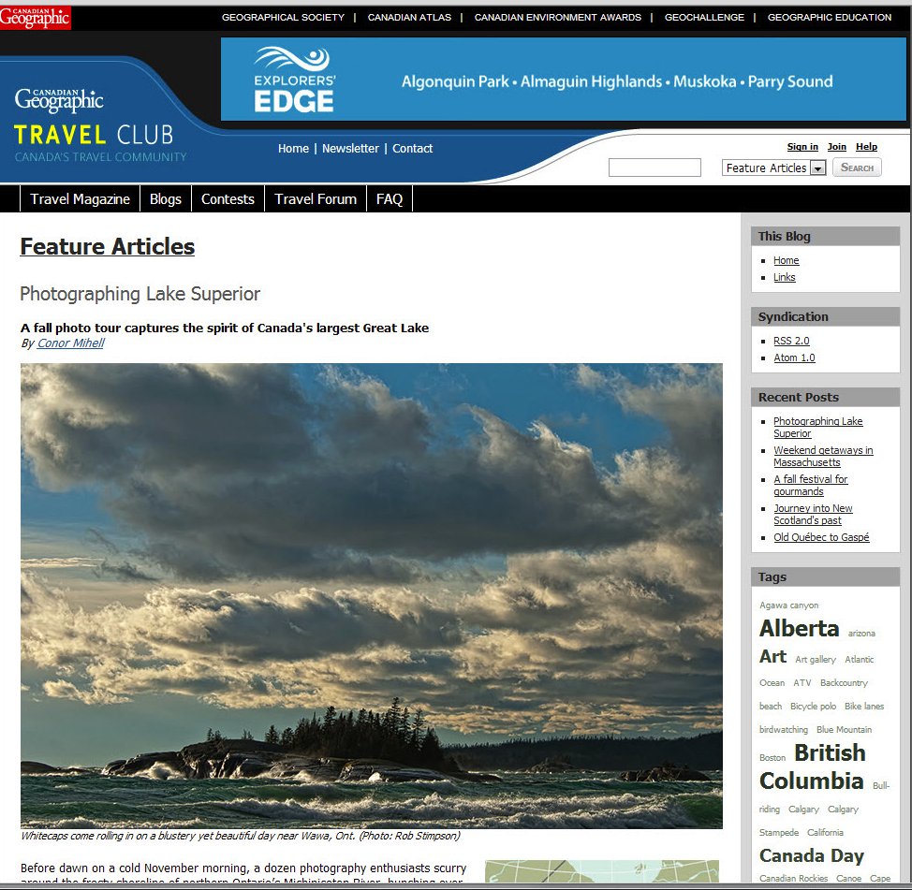
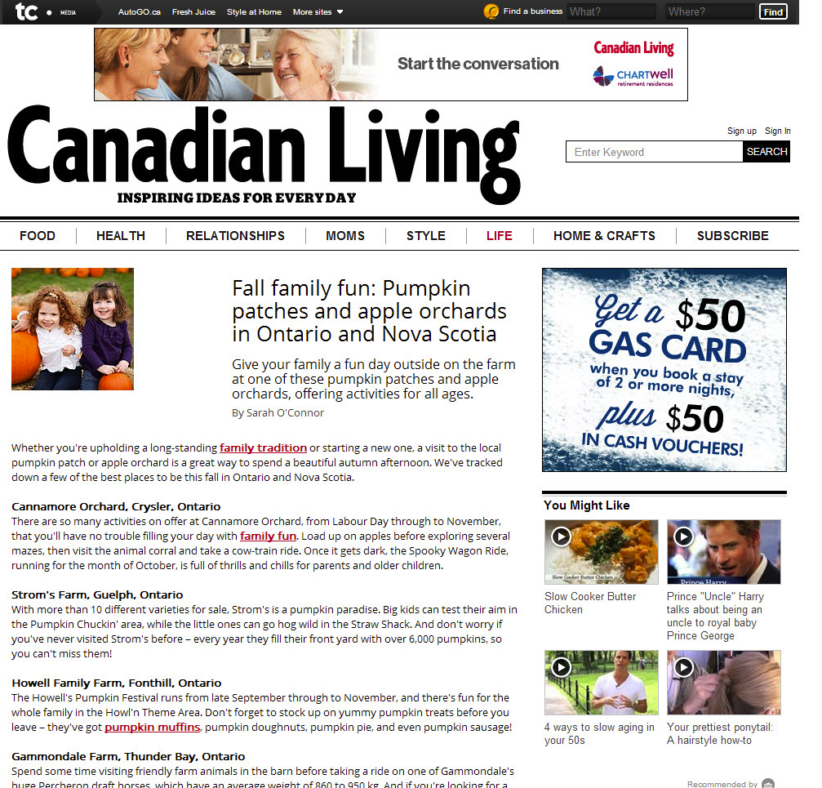
Online Display Ads
Toronto Star
The Star campaign (which included the NY Times) was a pay-per-impression campaign
NetMargins Network
Net Margins and Olive Media campaigns were exclusively pay-per-click
Two types of banner ad creative were used to drive traffic to EE.ca – big boxes and leaderboards

Slide 15
Observations
Overall, the CTR (as measured by visits registered on EE.ca) was 0.20% for the pay by impression campaign.
This is 100% higher than projected based on previous online campaigns for EE
The Fuel & Fun versions of the ads had a CTR of 0.28%, 86% higher than the ads without it
Special ad units such as wallpaper and pre-roll significantly outperformed the standard IAB units
The Wallpaper had a CTR 5x the average for the campaign, while the preroll was 3x the average
Recommendations
Dropping the leaderboard unit in future campaigns as it significantly underperformed the average
Best performing content sections on the Star:
Life (CTR 4.6x higher)
Custom Content (CTR 2.4x higher)
Travel (CTR 2.1X higher)

Slide 16
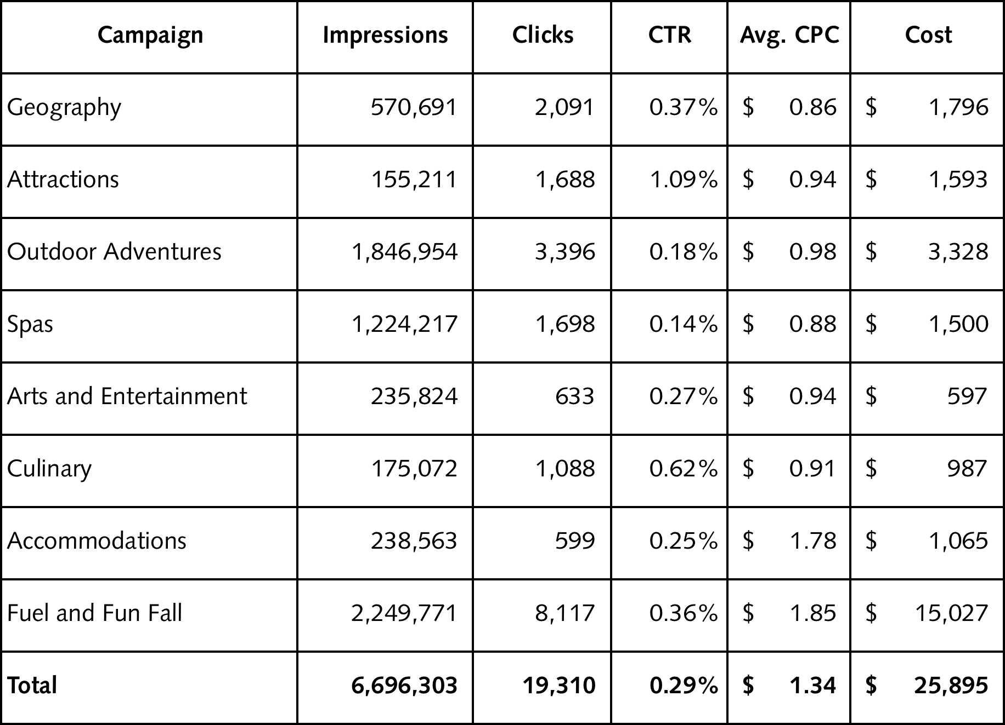
Google AdWords
Launched August 19
Fuel & Fun accounted for 60% of the total spend
Google Adwords
Delivered high quality traffic to EE.ca, with an average time on site of more than one minute.

Slide 17
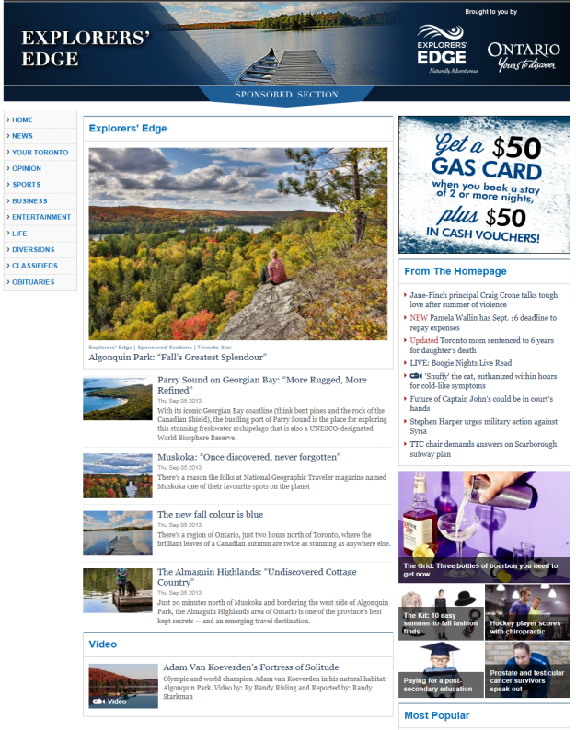
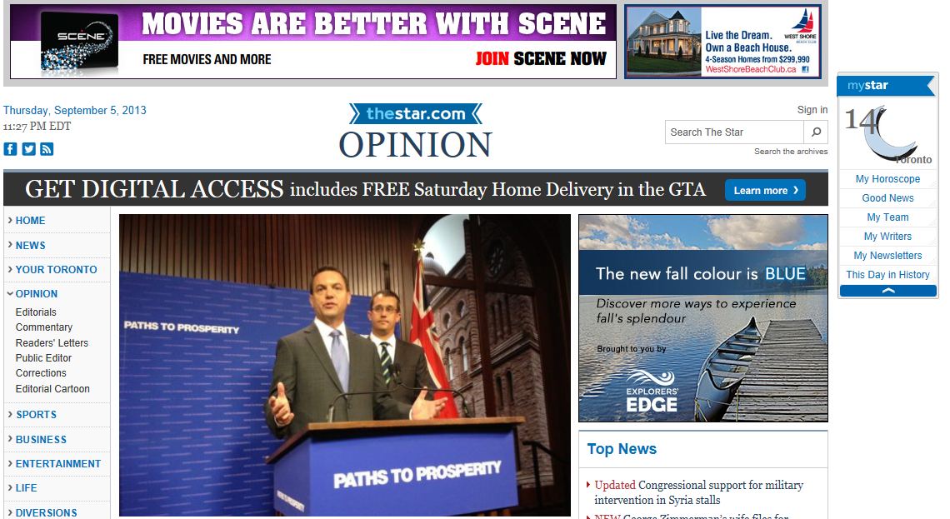
Toronto Star Content Hub
The hub was live from Sept.5 to Oct. 14, 2013
The content hub received
109,254 visits
drove 554 clicks through to EE.ca
The co-branded ads
3,000,229 impressions
7,920 click-throughs to the sponsored content hub

Slide 18
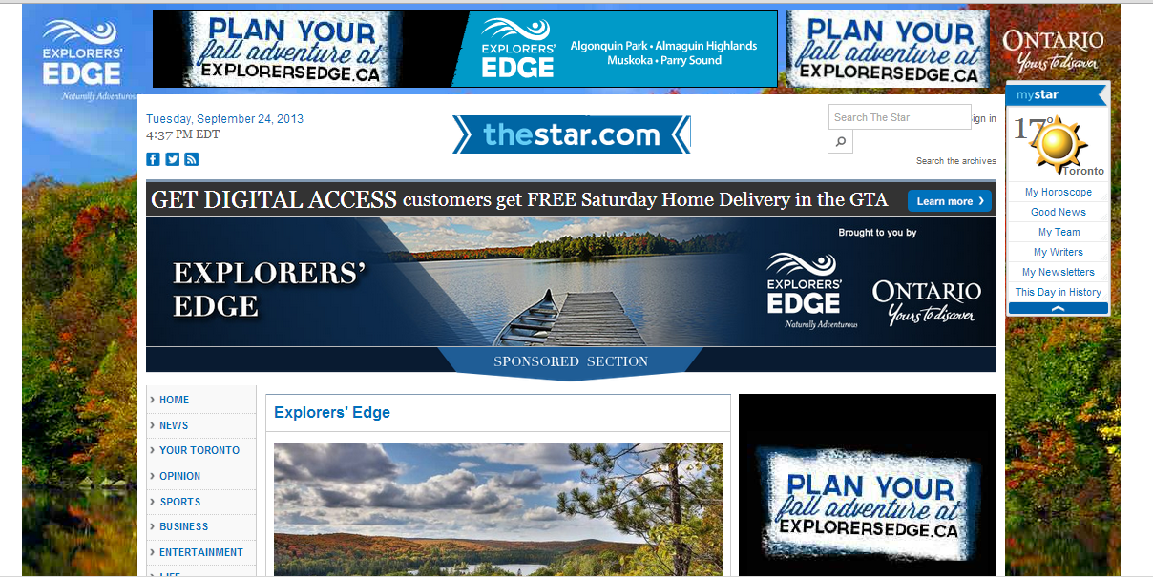
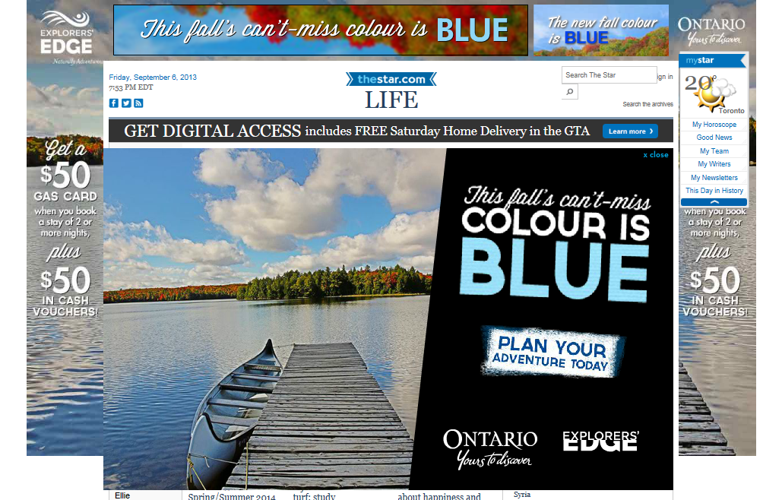
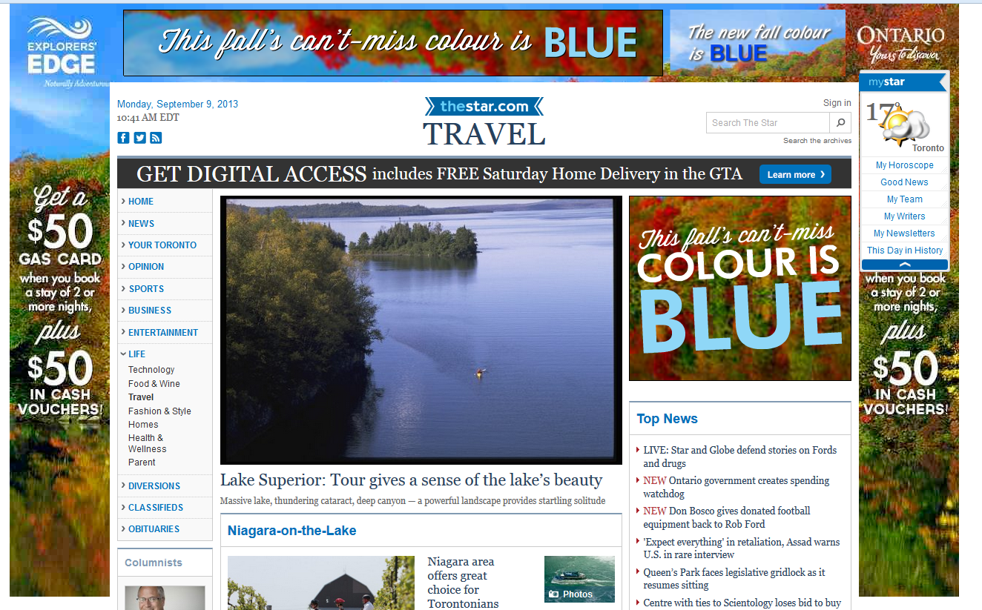

Slide 19
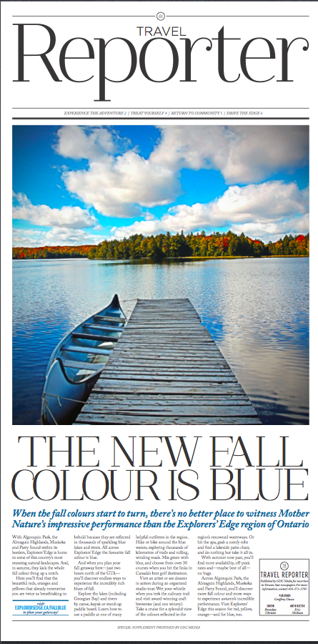
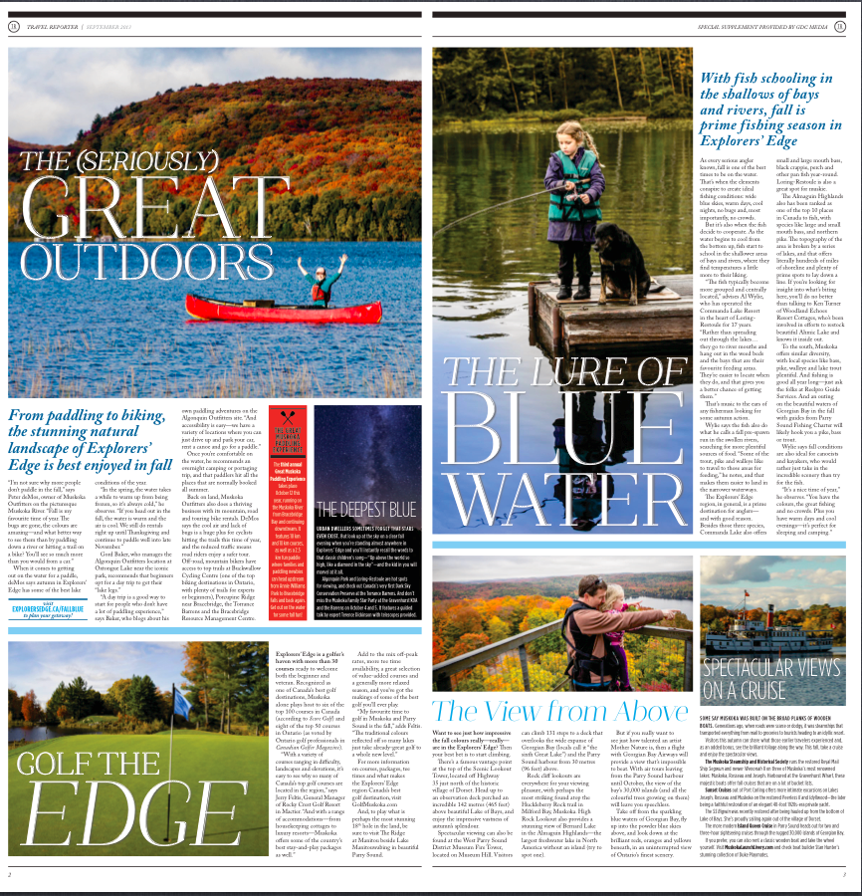
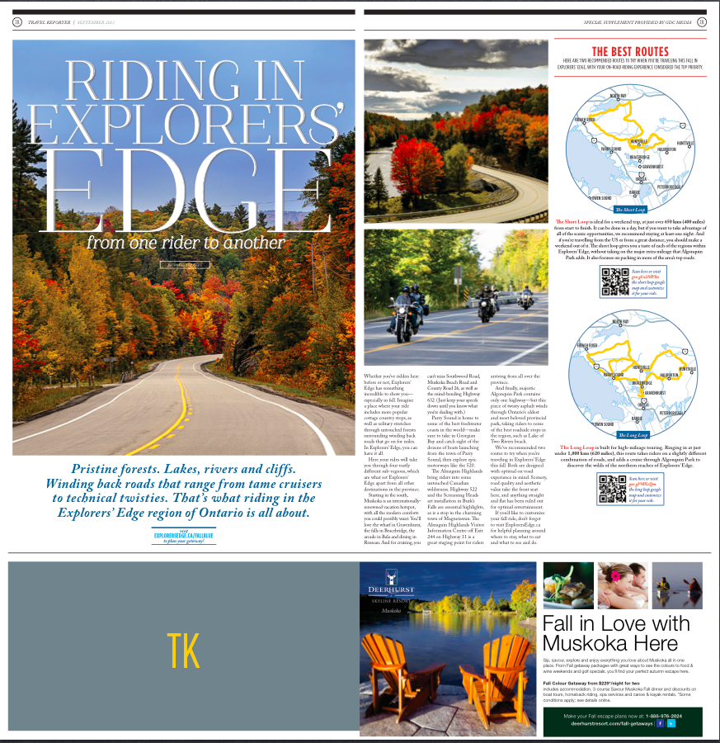
Toronto Star Print Insert
The supplement ran in the Sunday edition of the Star on September 15.
A total of 207,000 supplements were delivered to Toronto Star subscribers in the GTA.
An additional 10,000 copies of the supplement were also handed out in select areas of downtown Toronto.
The content in the Travel Reporter included 13 articles about things to do and where to stay in Explorers’ Edge in the Fall. And also included a full page dedicated to Ride The Edge.

Slide 20
Key Learnings

Slide 21
Moving forward we need to focus on more than just driving a high volume of visits to EE.ca. It makes sense now to add in engagement metrics – time on site and referrals to operator sites – as additional ways we will measure success
Facebook has emerged as the number one driver of visits to EE.ca. And these visits are very cost efficient, the Fall cost per click for Facebook was less than 20¢ and it is also effective at sending visitors on to operator sites
Non-traditional ad units including content are more effective at driving engaged visitors to EE.ca than traditional IAB units

Slide 22
Content hubs are like mini-microsites of EE.ca and visits to these hubs are almost as good as visits to our own site with their focused content
The fall campaign drove 80,000 visits to EE.ca but in addition, over 8,000 visits to the content hub on Toronto Star – all highly engaged visitors
Print, effective at driving incremental traffic – we see a spike in website traffic and are also effective brand builders
Recommend adding a question to the brand research survey asking responders about how far in advance their plan their fall getaways
It would be useful to get more information into the fall travel purchase process
consider if the fall campaign would be more effective if it started in August

Slide 23
Questions / Discussion

Slide 24
Draft 2014 Winter Marketing

Slide 25
BUDGET: $110k
Winter 2014 Campaign Theme: Nothing new under the sun
“Winter turns up the fun!”
Focus of our messaging is therefore on activities
Our audience has the perception that cottage country shuts down in the winter, and there’s nothing to do until the ice is off the dock
The target for our message: Connected Explorers
Those who engage in outdoor winter activities – these people are typically 25-64 and have higher than average affluence

Slide 26
As stated in the overall 2013 strategy
objective is to drive qualified visitors to EE.ca
Success will be measured by traffic to EE.ca
# of visits * time on site (industry standard) * pages viewed (industry standard)
The overall marketing strategy, therefore, has evolved since the beginning of the year to improve the “quality” of visitors to include those who are more engaged

Slide 27
Proposed Channel Plan
Maintain investment in Google AdWords
Maintain investment in Facebook
Leverage branded online content to drive engaged traffic
Test new 3rd party properties

Slide 28
We have reviewed results from the Fall 2013 campaign looking for findings that would help guide our creative and channel planning for Winter 2014
Just under 74,790 visits to the site from Sept. 2 to Oct. 15, these 6 sources accounted for 74,005 of these visits

Slide 29
Of the “paid” tactics employed in the campaign, Google Adwords and Facebook delivered the highest quality visitors
Google Organic 0:03:17
Direct traffic 0:02:41
Google CPC 0:01:07
Facebook 0:01:07
TorStar 0:00:46
NetMargins 0:00:33

Slide 30
Overall, during the campaign period
11,434 visitors were referred
DMO and other regional websites
This represents 14% of all visitors

Slide 31
A total of 49,655 clicks were generated by Facebook ads during the fall campaign, at a cost of just $0.40 per click, the lowest CPC of all marketing activities:
24,604 were generated by content promotion ads, of which 16,517 went to EE.ca (75% of all clicks sent to EE.ca by Facebook)
25,051 were generated by ads for the contest (these clicks went to the Facebook Page or Contest tab)

Slide 32
The investment in Facebook has paid off:
Facebook is now the number one driver of page view and engagement on the site
Facebook has become the most cost-effective way of generating reach for the EE content.
Contests and promoted content are equal contributors, driving visits to both the website and Facebook page

Slide 33
Engagement Best Practices
Best practices state if you drive all traffic to your home page, bounce rates will be higher.
Reducing bounce rates while creating more engagement on your website:
Start using landing pages with the Winter campaign to try and increase engagement on the site (time on site and page views) and drive more traffic to operator sites.
Industry benchmark see a drop of over 25 percentage points in bounce rate when unique landing pages are used as compared to when no unique landing pages are used

Slide 34
Conclusions
Facebook is a powerhouse for generating content engagement and drive traffic to the website
We should not reduce spend with Google Ad Words
Driving consumers to relevant content pages on the site based on the banner creative or the branded content
Continue using media that drive a high volume of engaged visits to EE.ca
It is important to invest in 3rd party media sites to help feed direct and organic search results
Continue to test new media to increase traffic and expand the selection of media that perform well for EE.

Slide 35
Channel Plan
Google AdWords
Targeting based on activity and regional keywords and driving to relevant activity content pages on EE.ca
Facebook
FB ads to promote content on site and FB posts
Winter activity contest app to drive fan-base engagement, new fans and Sojouner subscribers
Toronto Star
Display advertising on thestar.com plus sponsored content HUB on the site focused on winter activities in the EE region
Travel, Life and News sections – 289,075 impressions
Pre-Roll run of site ads – 58,633 impressions
Run of site ads on the Olive Lifestyle network – 1,412,230 impressions

Slide 36
Channel Plan – Test New Media
theweathernetwork.com
Leverage Where’s Kevin remote scheduled for Jan. 31st on the Ice Trail
6-week campaign of display ads targeted to GTA incl. Toronto and Southern Ontario:
500,000 website ads * 300,000 mobile ads * 200,000 tablet ads
2 takeovers in the GTA
Typically get between 250,000 to 540,000 page views depending on how active the weather is that day
Bonus: TWN will promote the Facebook contest on their site at no cost ($5,000 value)
Outdoor Canada
Create a sponsored content hub on the site
Will contain 8-10 articles, some will be existing articles from Outdoor Canada and of these EE will have approval
Patrick Walsh has been approached to write an article about his experiences in the EE region
City Parent.com
Banner ads on site plus on one e-blast
Banner ad big box will run for two months starting mid-December along with a bi-weekly eblast
OTMPC
Banner ad in promo spot in January and February - Site get 3.8MM visits a year

Slide 37
Publication | Cost
Google Ad Words | $30,000
Facebook Content | $9,000
Facebook Promo | $11,000
Weather Network | $20,700
Toronto Star (Content HUB) | $17,250
Toronto Star (Banner ads) | $0
OTMPC - Banner ad (monthly promo offer) | $690
City Parent | $1,265
Outdoor Canada | $6,000
Facebook App + Contest | $7,000
Creative Development + Production | $10,000
Total | $112,905
Focus on the many outdoor activities to do in the region in winter
Build on the campaign and awareness started last year
Re-use the existing Winter Turns Up the Fun creative:
EE.ca content is king and fundamental to the campaign:
Develop weekly content for website and Facebook page focused on key activities
Switch focus of activities each week
Re-use the Winter activities Facebook app from Winter 2012 campaign

Slide 38
Questions / Discussion

