Slide 1

Research Tracking and Measurement
October 21, 2013

Slide 2
Overview
Brand Health
Program Metrics
Visitor Exit Survey
Business Index
Analysis / Presentation

Slide 3
Brand Health
Quantitative Research Study – RTO12.ca
2012 – 1230 sample
2013 – 530 sample
Awareness of Explorers’ Edge amongst the all-important Ontario Explorers segment: Coordinated Analysis
2014 Quantitative Research Study
Consult RTO’s
Track brand health
Budget - 20k

Slide 4
Program Metrics
Signature Programs
Fuel and Fun
Explore the Edge
Booking, Redemption, Travel Patterns, Consumer insight
Marketing
Website Visits / Unique URL’s
Outbound Traffic
Time on Site
Budget N/A
Included

Slide 5
Visitor Exit Survey
Visitor Exit Survey
In-house tracking & Design
I-Pad
Incentive, gas card
Regional Operators
KOA Parry Sound, Cleveland's House, Sunny Point Resort, Motel 6, Hidden Valley, Sherwood Inn, Tally Ho
Budget $7,300
In-House

Slide 6
Business Index
Data Collection
Historic and Current
Monthly
Segal LLP
example
Budget $11,000
1. HST
2. Rounds of Golf
3. Gate Receipts

Slide 7
Business Index
Occupancy
PKF, Hospitality & Tourism Business Advisors
Accommodation Industry Tracking Tool
18 Accommodations in RTO12
Weather & Provincial Park
Cloud / Project Management
Precipitation
Arrowhead & Algonquin
Budget $7,000
4. Occupancy
5. Provincial Park
6. Weather

Slide 8
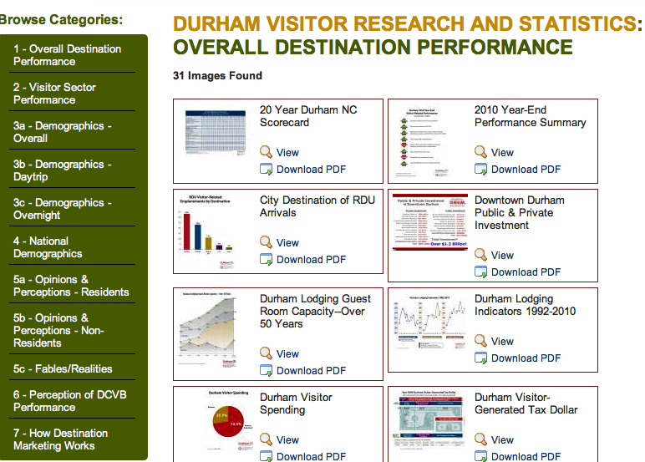
Online Presentation
Budget $3,500

Slide 9
Analysis &Presentation
Cloud Ad Agents
Project Management (5 months, $1,400)
Presentation (Jan & Mar)
Coordinated Analysis
Strategic Direction
Industry consultation i.e. Pure Muskoka, RCMG, TNS, David Foote
Industry Consultation
Presentation Material / circulation
Project Management
$7,200
Jan & Mar
$4,000
Strategic Direction
$8,000
Industry
$2,000

Slide 10
Budget
RESEARCH TRACKING AND MEASUREMENT
Tourism Indicator Framework
Brand Health (Research House, Hilton Barber, Cloud) | 20,000.00
Program Metrics | N/A
Visitor Exit Survey (In House) | 7,300.00
Business Index
Data Collection (Segal LLP) | 11,000.00
Occupancy Rates (PKF) | 7,000.00
Online Creative (Link-House) | 3,500.00
Project Management (Cloud) | 7,200.00
Tourism Indicator Framework
Jan Report / Presentation (Cloud) | 2,000.00
March Report / Presentation (Cloud) | 2,000.00
Industry Analysis
Pure Muskoka, RCMG, TNS, David Foote | 8,000.00
Industry Presentation Material
Creative / Hard Costs | 2,000.00
TOTAL BUDGET 2012/2013 | 70,000.00

Slide 11

Questions

