Slide 1

Transacting Committee
Reconciliation
December 6, 2013

Slide 2



Current Programming
Spring Fuel and Fun
Explore the Edge
Fall Fuel and Fun
Winter 2014

Slide 3
Fuel and Fun
Spring & Summer 2013

Slide 4
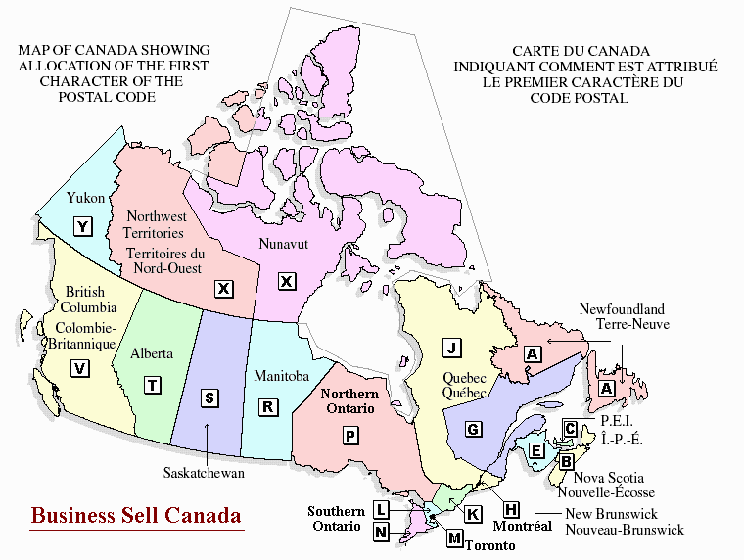

Slide 8
Observations
Value of Accommodation Bookings
$82,000 Spring vs $160,000 Fall
$193 average room rate
Redemption Results for Fuel and Fun
Leverage dining to promote travel
Retail – Includes Outfitters
White Squall in Parry Sound - $1,500 vouchers
Out fitter shop – some were rentals

Slide 9
Moving Forward
Target Advertising in regions where we want to build new audiences
Attempt to lengthen stays by increasing offer if you book more nights
Retail and Dining has the potential to build tourism
Arizona Grill – over $1,000 voucher redemption
Integral mix FOR CONSUMERS

Slide 10
Explore the Edge
Summer 2013

Slide 11
Explore the Edge
Distributed
7,175
Redeemed
3,973
Redemption
55.37%

Slide 13

Explore the Edge
ETE launched on July 2. By July 8, all coupon books were completely subscribed
Key metrics for the app:
Visits - 3,657
Page views - 17,748
Total Unique subscribers - 1,310 (36% of visits)
Newsletter Subscribers - 846
Outbound clicks to businesses from app - 873

Slide 14
Observations
Very Successful
Did convert fans to travellers
64% who redeemed were on our Facebook Page as fans
79% of subscribers said that the promotion influenced their decision to visit Explorers’ Edge!
42% said they had never visited the region before

Slide 15
Potential
Leveraging Santa’s Village
Power to bring people to the region
Leverage SV to get bookings and introduce travellers to new attractions
SV has the marketing reach to build the region in the summer – other attractions can benefit

Slide 16
Reconciliation

Slide 17
Program Reconciliation
Winter 2014
Voucher Redemption
$91,000
Logistics
$6,000
Infrastructure & Design
$30,000
Explore the Edge
$18,000
60% Redemption Rate
600 packages
Logistics, Infrastructure, Design
$2,000

Slide 18
Transacting - 2014
Committee Commitments
Signature Program
Reservation System
Coupon or Gift Certificate Program
Transacting Committee
Goal
Outcomes
Outputs

Slide 19

Questions

