Slide 1

Intro to Explorers’ Edge Partnerships
Canador College, Parry Sound, ON
Tuesday April 11, 2017

Slide 2






A little history…
RTO12 developed Product Development Fund [show examples…group of seven strategy etc]
First among RTOs
Phased out with introduction of Partnership Program introduced by MTCS
• Friends of Algonquin Park – Development of HD video and photography in order to develop their outdoor educational programming
• Canador College – Development of ecotourism packages in the Georgian Bay Biosphere – UNESCO World Heritage Site - that combines tourism partners and education i.e. Educational Ecotourism Packages
• Park 2 Park – Creation of an incentivized program with private-sector partner to explore the viability of increased trail use(outcomes will be applicable to trails across the region)
• Stockey Center – providing the Stockey centre with the tools to engage an audience at the Incentive Works Trade Show to position the Stockey Centre and Parry Sound as a viable conference and corporate event destination
• Huntsville/Lake of Bays Chamber of Commerce – Tom Thompson 100 Year Celebration Initiative, worldwide recognizable art figure – EE will support way-finding signs at the event – one portion of the submitted budget
• Town of Bracebridge – The Art of Muskoka Living – Showcase Weekend – EE will pay the videographer & photographer directly

Slide 3
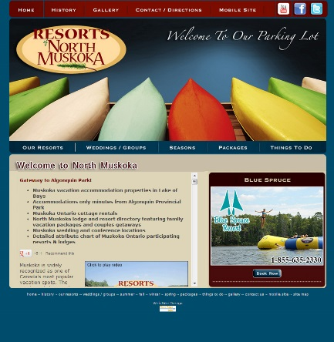
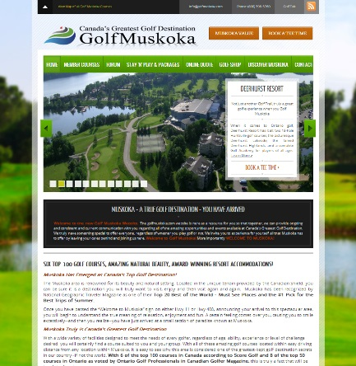
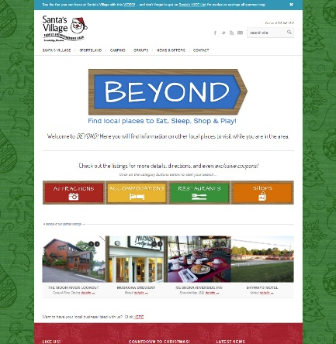
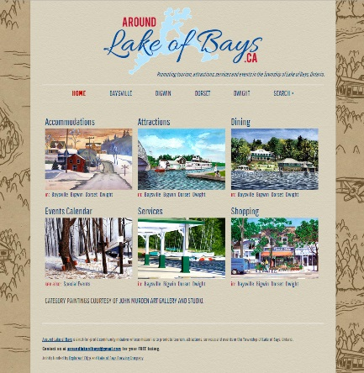
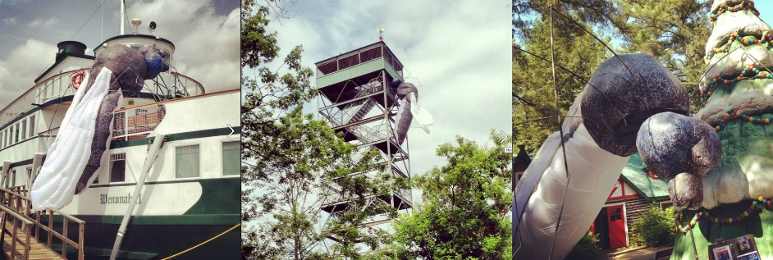
First Few Years
Business Proposals:
Business Plans
Social Media
Websites
Regional Branding

Slide 4
2016-2017
Attempt to streamline based on what was submitted over years and based on objectives of RTO12
Festivals & Events
Content Marketing
Workforce Development
Partnership
Minimum 50 / 50 project cost sharing
Partner remits payment to the RTO – the RTO then pays third part to execute a project

Slide 5
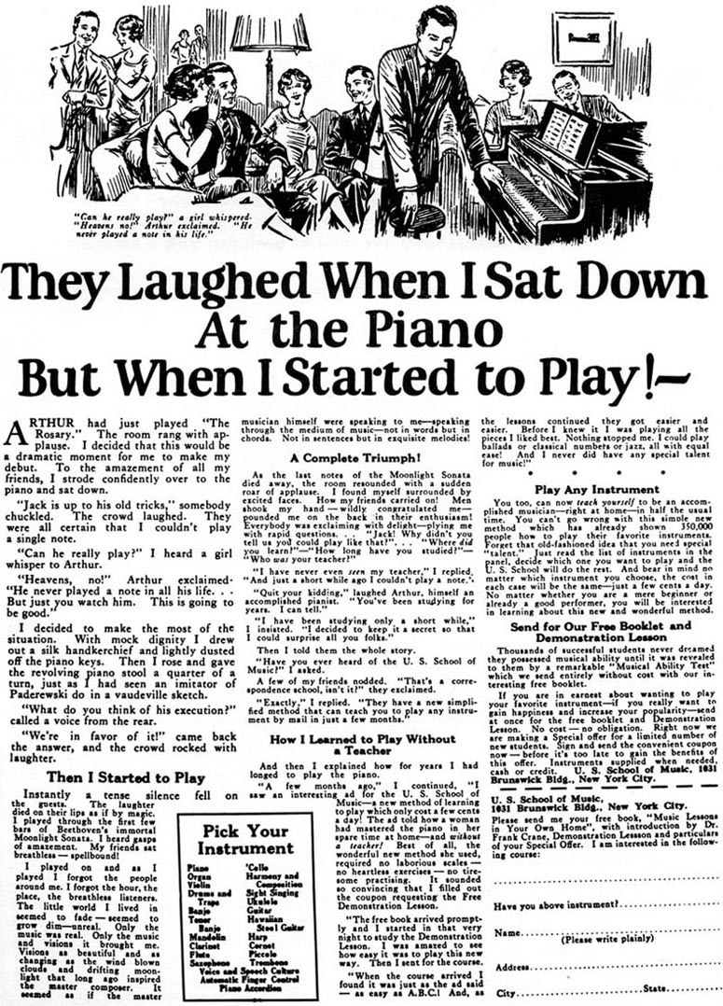
Direct Response Advertising and the Long-Copy Writer
Captivating headline
Tell a story
Strong call to action
Convince and convert with content
TRACKABLE
BEST BET REACH

Slide 6
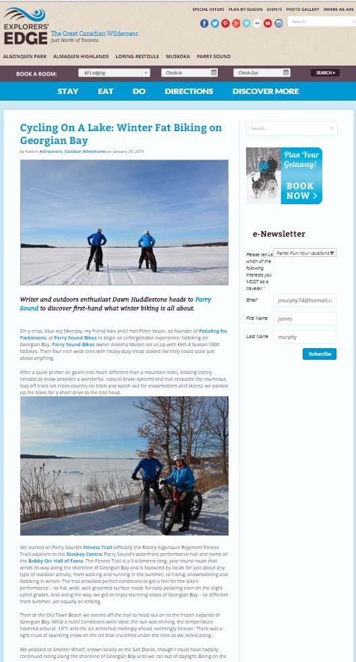
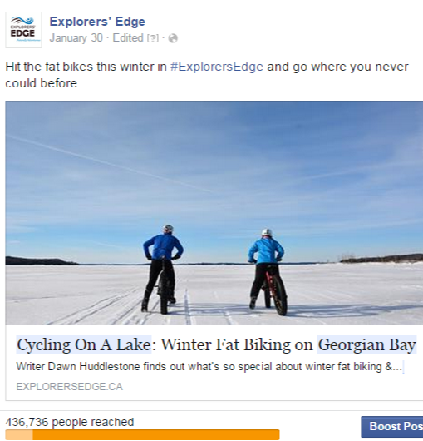
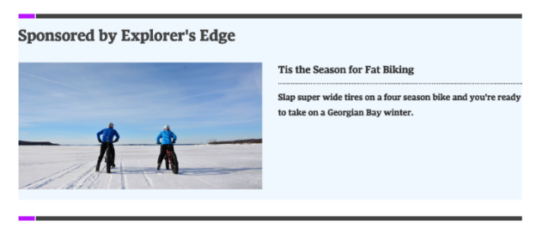
The Return of Direct Response Advertising (and the rise of content marketing)
The rise of the long-copy blogs that get audience engagement
Captivating headline
Tell a story
Strong call to action
Convince and convert with content
NOW targeting is key and social media data allows for this
TRACKABLE - TARGETABLE

Slide 7
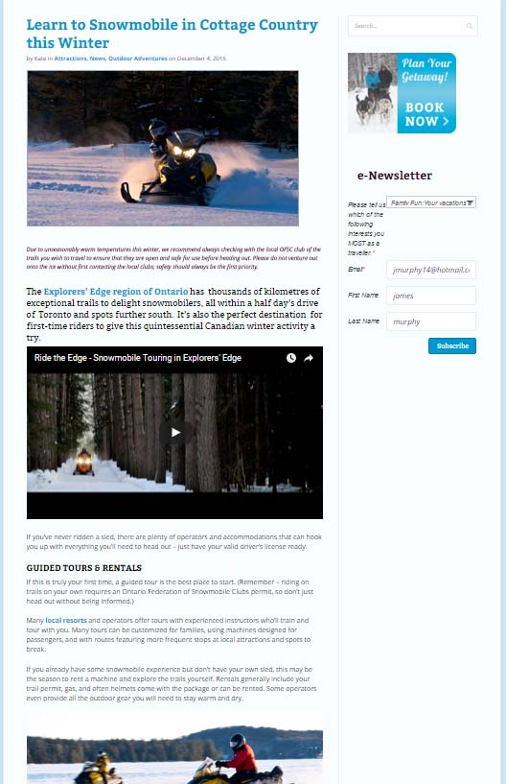
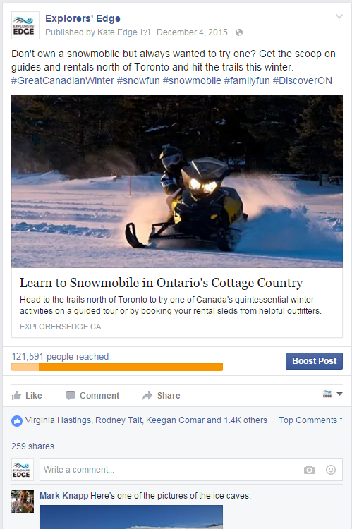
We Create Content Then Target Facebook Users
THE AD
THE
MEDIUM

Slide 8
Quick Tips for Content Marketing
Create stuff that people like to read or watch, and the sales will follow
DON’T use a hard sell, and don’t put your sales pitch where it doesn’t belong because it annoys people
Play the long game to get conversions

Slide 9
Quick Tips
Figure out your target audience
Always use great photos
500-700 words
Include a call(s) to action
Captivating headline
Try to find a “hook” (…it’s very competitive in the social world and the consumer is in charge of changing the dial)
Choose which channel to promote content
#1 - be helpful and informative…don’t be advertiz-y
Find a storyteller at your business and have them write down their words/stories/pitches

Slide 10
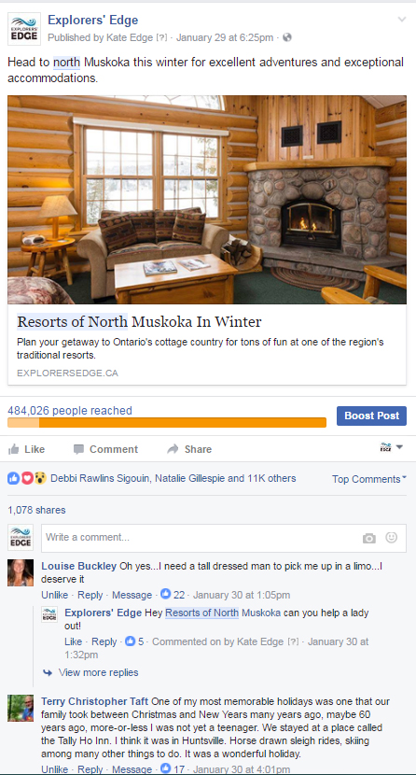
Partnership - Content
Loring / Restoule
Kee to Bala
Santa Fest
Deerhurst Resort
Georgian Bay Airways
Club link (Sherwood Inn & Rockey Crest)
Resorts of North Muskoka
Huntsville Chamber of Commerce
Oar and Paddle
Pine Grove Resort
Georgian Bay Biosphere

Slide 11
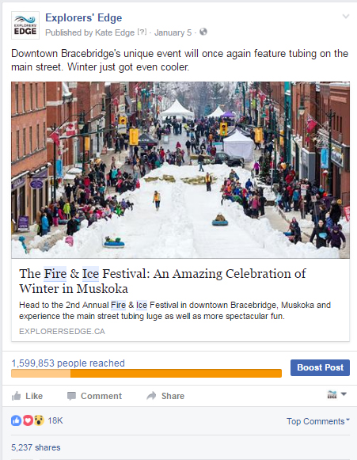
Partnership - Event
What's Cooking Bracebridge
Muskoka Autumn Studio Tour
Muskoka Beer Festival
Great Muskoka Paddling Experience
Girlfriends Getaway Weekend
Yoga Festival
Active Women's Winter Weekend
X-mus Event
Maple Syrup Festival

Slide 12
2016-2017 Observations
RTO12’s objectives with Partnership Fund need to be more clearly defined so we don’t end up just doing another org’s marketing
Need to ensure there are partnerships from all 5 sub-regions when possible
Need to stage content marketing throughout year so it is most effective in winter and spring shoulder seasons
Expectation that once an event has partnered with us twice, new events should be given consideration instead to “prime the pump”
Need to earmark % of funds for small business partnerships, and for bigger spend with corporate sponsors and government agencies where possible
Need to manage editorial to avoid duplication in the marketplace

Slide 13
What stays the same year over year
Partnerships must benefit multiple stakeholders,
Build visitation especially in shoulder seasons
Change perceptions of the region as summer-only destination for the rich
Build new audiences

Slide 14
Content: How It Works
Draft Scenario:
meeting with EE staff to determine mutual objectives and strategy (if any are possible)
Consult with Director of Communications & Marketing Strategist
Content Development (content must live on EE website)
2 pieces of content per project MAX
Targeting through EE FB page
Fixed timeline for promo
Report after results

Slide 15
Recommendations - Moving Forward
Review of the current framework to be created
Meeting with stakeholders and reviewing best practices
Advance signing of the MOUs:
45 development period
Allow the team to complete work on our end
Ensure alignment & effective use of resources
Based on Interest of the Content Program:
Develop a multi-level program to ensure all businesses have opportunity to participate

Slide 16
Moving Forward: Timeline
Review 2016 Outcomes
Meet with stakeholders, gauge interest in 2017
Product Development Strategy – Quarter 1 April – June
Recommendation - Product identified will be priority for strategic partnerships
Content will be for fall, winter or spring seasons
Must finish by March 31, 2018

Slide 17
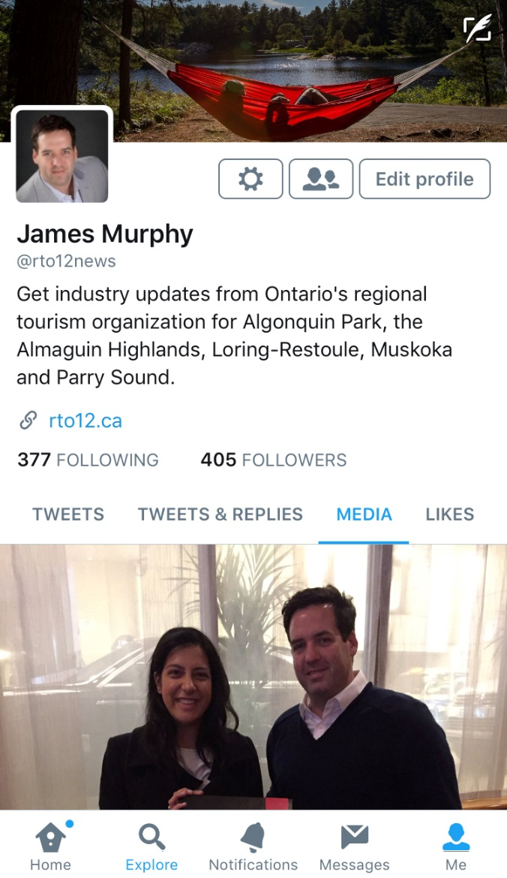
Questions

